Slide 1
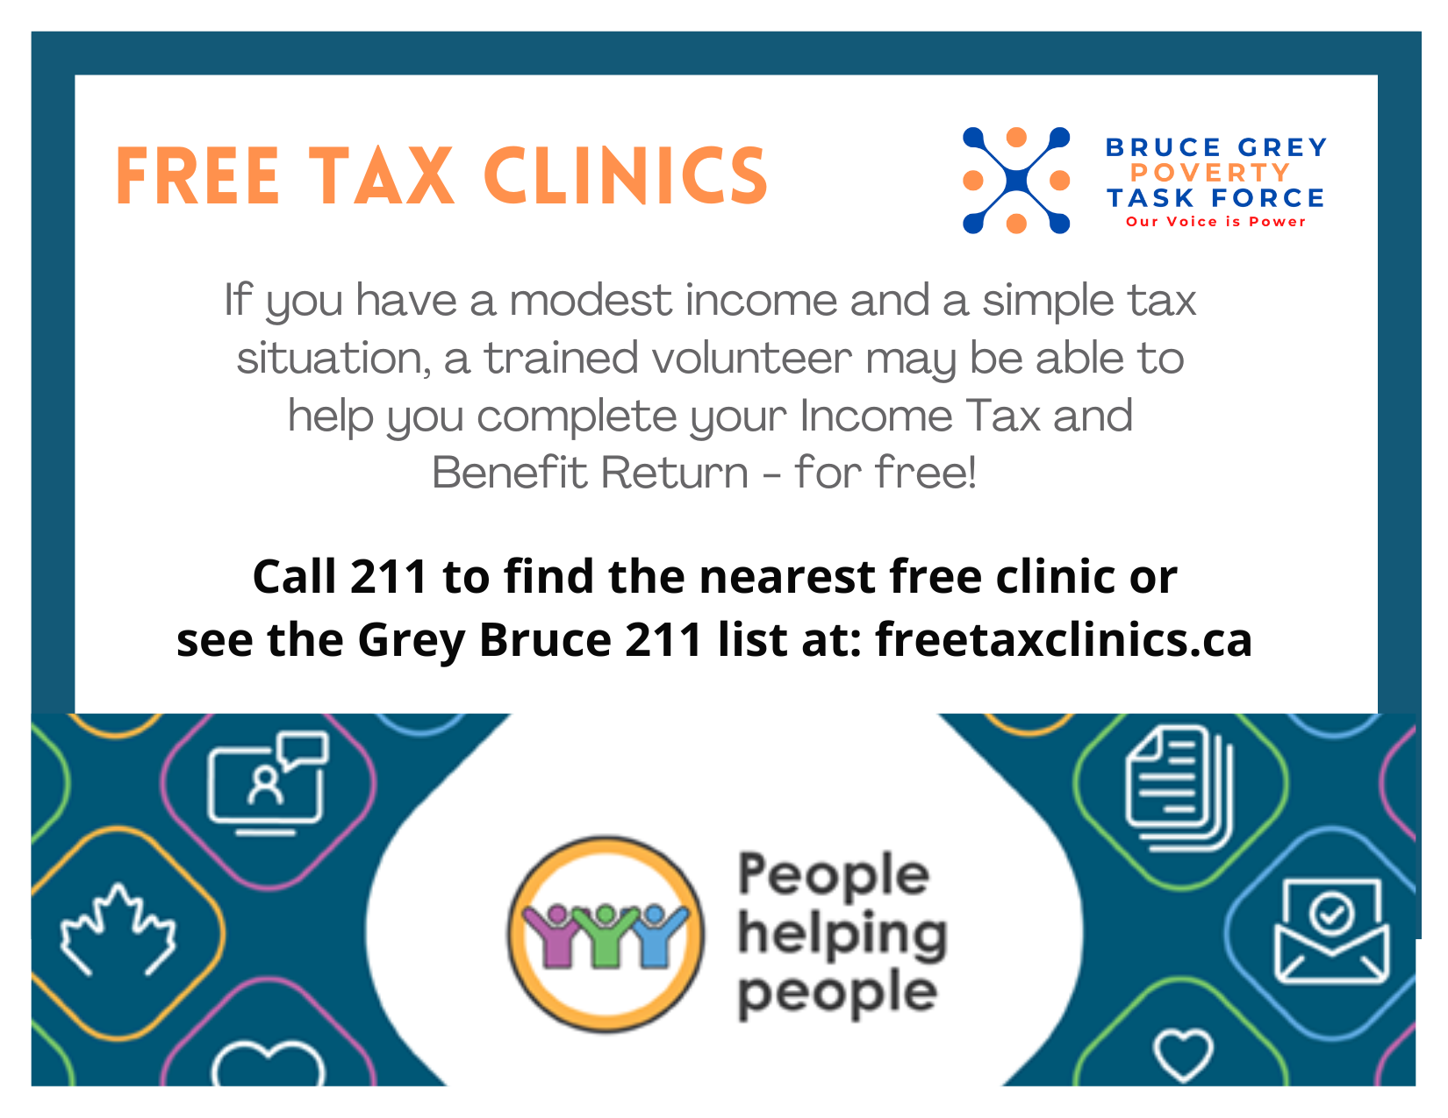
Community Volunteer Income Tax Program

Slide 2
Community Volunteer Income Tax Program
The Grey Bruce Community Volunteer Income Tax Program (CVITP) continues to be a critical tool in reducing poverty and strengthening income security across the region.
Free Income Tax clinics where volunteers complete and e-file returns for people with a modest income and a simple tax situation.
In 2025, eligibility was a modest income of $35,000 for individuals, $45,000 for couples, plus $2,500 for each dependent. This has gone up $5,000/person in 2026.
17 CVITP registered organizations in Grey Bruce completed 3,368 tax returns ($3,100 average x 3,368 = $10, 440,800) in 2025.
$10,440,800 was returned to residents in Grey Bruce for the year ending 31 December 2025. (Using an average of $3,100/tax return).
In addition to refunds and benefits, the program saved local residents an estimated $421,000 by providing free tax filing services — money that would otherwise have been spent on paid tax preparers.
Despite this impact, only a fraction of those eligible are currently accessing the program. In Grey Bruce, an estimated 41,400 people qualify for CVITP services, highlighting both the scale of need and the opportunity for growth.
Notes:
Simple Tax – no rental, business or self employed income
- no capital gains or foreign income
- can’t complete returns for deceased or estates
Income – the income levels are not a hard line. We have a lot of leeway. Circumstances can change quickly, so we look at things as they are at the time of filing, not necessarily from the prior year
Income level are changing in 2026 for the 2025 tax year.
Family size Total family income
1 person $40,000
2 people $55,000
3 people $60,000
4 people $65,000
5 people $70,000
More than 5 people $70,000, plus $5,000 for each additional person

Slide 3
Community Volunteer Income Tax Program
Why we do it:
Refunds and benefits;
GST/ HST credit (now CGEB in 2026)
Ontario Trillium Benefit
Canada Child Benefit
Ontario Senior Homeowner’s Property Tax Grant
Climate Action Incentive (Carbon Tax rebate)*
Guaranteed Income Supplement (GIS)
Ontario Guaranteed Annual Income System (GAINS)
Canada Disability Benefit**
Notes:
OTB – a tax-free monthly payment for low-to-moderate income Ontarians, combining the Ontario Energy and Property Tax Credit (OEPTC), Northern Ontario Energy Credit (NOEC), and Ontario Sales Tax Credit (OSTC), designed to help with energy, property tax, and sales tax costs.
OSHPTC - seniors in Ontario who own and live in their principal residence and pay property taxes. Eligible seniors, aged 64 or older, can receive up to $500 annually, with the amount depending on income, marital status, and property taxes paid.
*CIA – Discontinued in 2025, but first quarterly payment was sent out in April
GIS - The Guaranteed Income Supplement (GIS) is a monthly payment you can get if you are 65 or older. The Supplement is based on income and is available to Old Age Security pensioners with low income. It is not taxable.
GAINS - GAINS payments are provided on top of the Old Age Security (OAS) pension and the Guaranteed Income Supplement (GIS) payments you may receive from the federal government. Eligible seniors can receive up to $90 per month. Based on income, age and marital status
**CDB - a new federal program providing up to $200/month (max $2,400/year) to low-income working-age Canadians (18-64) with disabilities, starting payments in July 2025. Eligibility requires Disability Tax Credit (DTC)

Slide 4
Community Volunteer Income Tax Program
Why we do it:
Program eligibility:
Canadian Dental Care Plan
Ontario Works /Ontario Disability Support Program
Registered Education Savings Plan – Canada Learning Bond
Registered Disability Savings Plan – Canada Disability Savings Bond and Canada Disability Savings Grant
Seniors Co-Payment Program
Trillium Drug Program
Low Income Energy Assistance Program (LEAP)
Ontario Electricity Support Program (OESP)
County Housing/RGI
Notes:
CDCP–federal government program to provide coverage for all Canadian residents who do not have access to dental benefits and have a household income of less than $90K a year.
RESP/ CLB - available for eligible children from low-income families It provides an initial payment of $500 for the first year the child is eligible, plus $100 for each additional year of eligibility, up to age 15, for a maximum of $2,000. Money will be deposited directly into the child's RESP.
RDSP/ CDSB - Grant that the Government of Canada pays into a RDSP. The government will pay a matching grant of 300%, 200% or 100%, depending on the beneficiary’s adjusted family net income and the amount contributed.
RDSP/ CDSB - Bond is paid by the Government of Canada directly into an RDSP up to $1,000 a year to low-income Canadians with disabilities. No contributions have to be made to get the bond. The lifetime bond limit is $20,000. The amount of the bond is based on the beneficiary’s adjusted family net income
Seniors Co-Pay - Program (under the Ontario Drug Benefit (ODB) Program provides financial assistance to qualifying seniors by reducing their out-of-pocket drug costs. All OHIP-insured seniors aged 65 years and over automatically qualify for the ODB Program. Reduces co-payments to$2 or less per prescription Single income $25K or less. Couple $41,500 or less
OTP - Ontario government program helping with prescription drug costs. for those under 65 or not on social assistance. Annual deductible based on income
LEAP – Emergency financial help with hydro and natural gas arrears. Up to $650, based on income and family size
OESP - program that lowers electricity bills for lower-income households. The OESP provides a monthly credit to eligible customers based on household income and size. Credits are applied directly to customers’ bills.
Grey County Housing – rent is based on income

