Slide 1


Improving Equity in Access to Palliative Care
A Community Partnership through the OHT
Funded by Healthcare Excellence Canada and the Canadian Partnership Against Cancer (the Partnership)

Slide 2
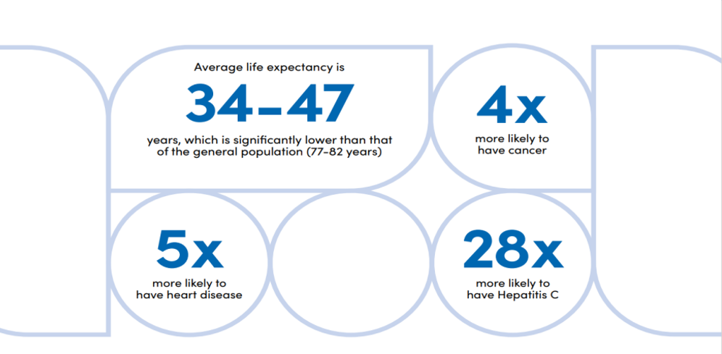
Why do we need equity in access to palliative care?
People Who are Homeless in Canada
Notes:
And Indigenous people make up a disproportional number of homeless individuals

Slide 3

Barriers to accessing palliative care
Geographic
Discrimination/Stigma
Cultural/Language Barriers
Competing Priorities
Less personal resources
Difficult to Diagnose Due to
Multiple Symptoms
Shortage of Specialized
Professionals
Notes:
Geographic:
Rurality
Transportation
Discrimination/Stigma:
-Racism
-Classism
-Homophobia/transphobia
-Ageism
-Stigmas around substance use
-Internalized stigma
Feeling undeserving of care
Feeling they can’t be helped or “It’s too late”
Cultural/Language Barriers:
-Indigenous cultural practices, histories, knowledge and healing are not prioritized or respected
-Mistrust of Western Medicine
-Different dialects/ability to codeswitch
Competing Priorities:
Food, shelter, time, personal belongings, substance dependence
Less personal resources:
-Financial resources
•Health Literacy and system navigation
•Health insurance
•Support from family/friends/community
•Communication skills
•Mental Health Support
•Primary healthcare provider
•Contact information (phone number/e-mail)
•Somewhere to go to get well

Slide 4

What does the IEAPC Navigator Do?
Needs Assessments
Meeting with people/agencies involved in participant’s care to coordinate and advocate
Transportation to appointments, shopping, court, etc.
Locating participants who do not have a cellphone/internet access
Delivering food and other essential items to people living in rural locations
Directing to medical/palliative care services
Assisting with housing applications/advocating for appropriate housing
Connecting patients with housing before hospital discharge
Referring to free Income Tax and Identification Services
Advance care planning
Emotional Support
Physical Supports (walkers/wheelchairs/shower seat)
Support in appointments and Emergency Department
Notes:
Physical support – ppl leaving stuff in my office to go to appointments

Slide 5
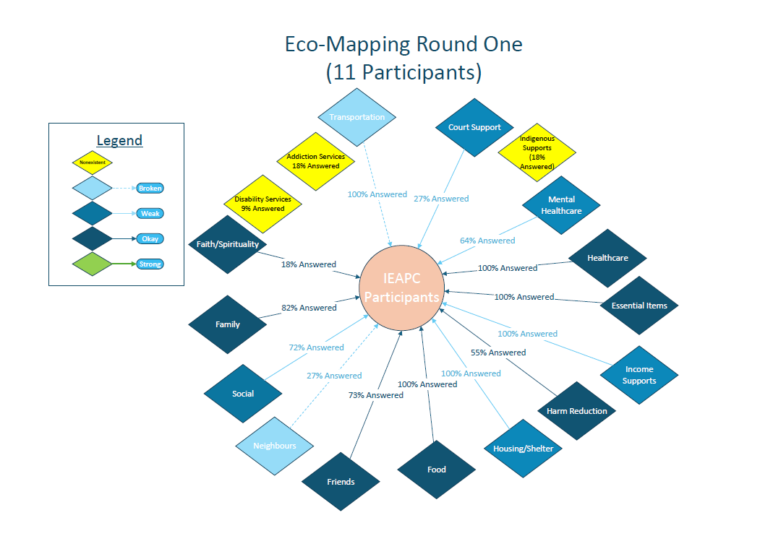
17 Needs
12 Functional Supports
2 Broken Support
3 Nonexistent Supports

Slide 6
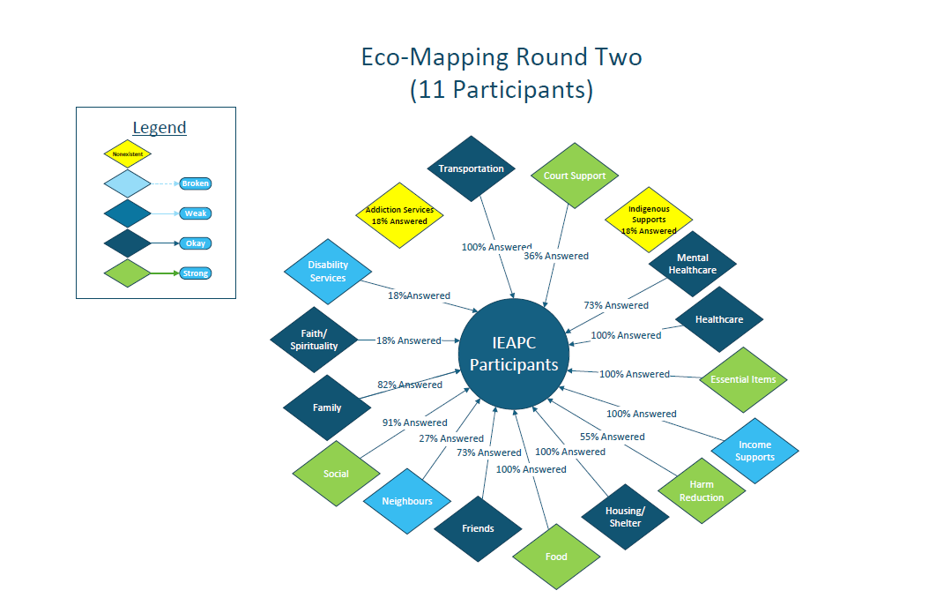
Notes:
2 Weak to Strong
3 Okay to Strong
2 Weak to Okay

Slide 7
48 Total Referrals
Referrals from 14 different sources
484 Encounters
18 Discharged
24 Current participants
8 deceased
All Participants homeless or vulnerably housed
6 people Became housed
8 Participants identify as Indigenous
83% received mental health support they would not have otherwise received
All participants received transportation assistance
Over 8000 km driven for appointments
All participants surveyed feel they are treated with dignity, respect, and compassion

Slide 8

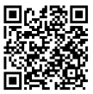
Let’s Connect!
www.safensoundgreybruce.ca/palliativecare
Phone: 519-379-1884
E-mail: ieapc@safensoundgreybruce.ca
Hypercare

Slide 9


