Slide 1



RETIRING ON A LOW INCOME
NEW PRESENTATION 2026
Learning the personal income tax system: Module 2
John Stapleton
22 May 2026
Photo by BDS.Photo on Unsplash

Slide 2

RRSP VS. TFSA
Are they the same?

Slide 3
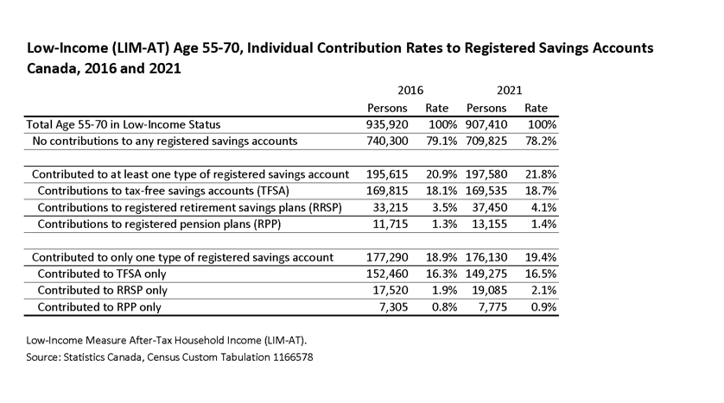
Most low income 55-70 year olds who contribute to a registered plan contribute to a TFSA

Slide 4

TAXABLE INCOME
Taxable income is the amount on line 26000 (Line 260 in 2019) of your tax form.
You pay no tax if:
Taxable income is about $17,000 and you are under 65
Taxable income is $22,500 and you are 65+
What does “taxable income” mean?

Slide 5
How to calculate your taxable income?
Total Income = Employment Income + CPP + Employment Insurance (EI) + Other Income + Self-employment income + Non-taxable benefit income –line 15000
Total Income – Deductions = Net Income OR Adjustable Family Net Income (AFNI) – line 23600
Taxable income or income subject to taxation = Net Income - Non-taxable Income and non refundable credits – line 260

Slide 6
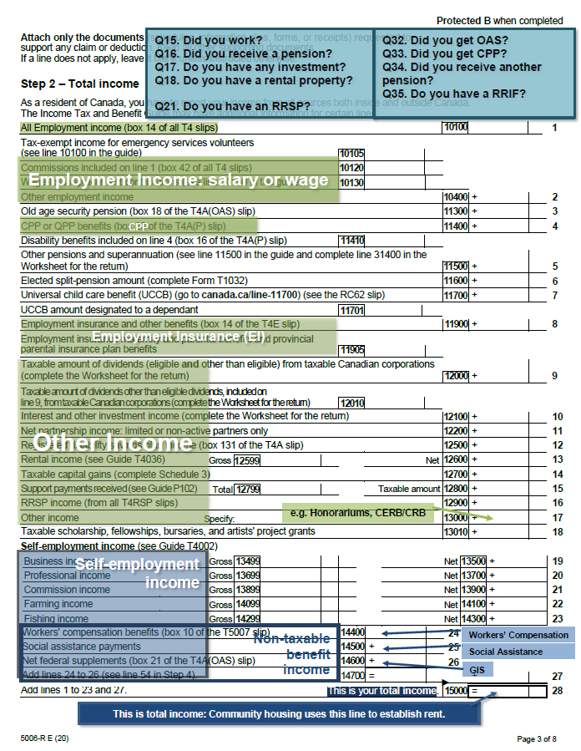
Total Income
Add lines 10100 (line 1) to 14300 (23)
  Employment Income
  CPP
  Employment Insurance (EI)
  Other Income
  Self-employment income
Add line 14700 (27)
  Non-taxable benefit income

Slide 7
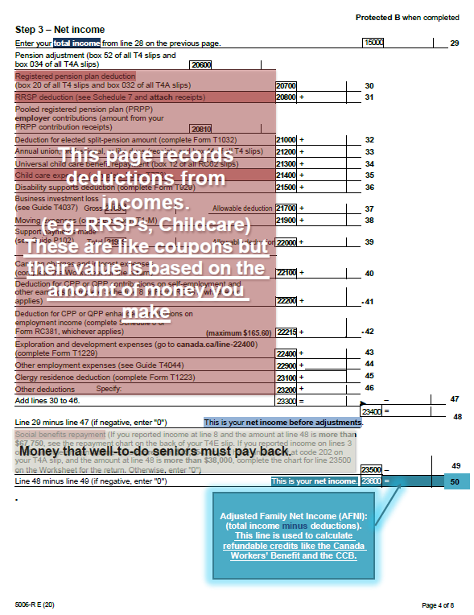
Net Income
Total Income – Deductions = Net Income (Line 23600/Line 51): Adjusted Family Net Income (AFNI)
Deductions (Line 23300/47): Add lines 20700 (30) to 23200 (46)
Non-taxable income: (Sum of Line 52 to 60 or Line 24400 to 25600)

Slide 8
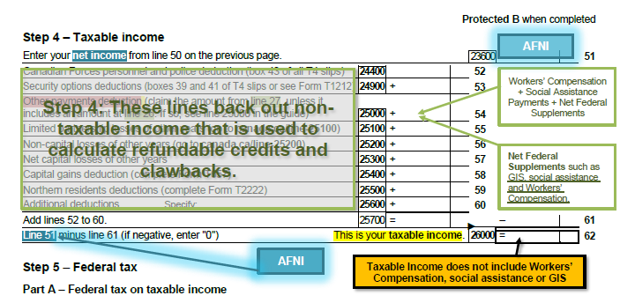
Taxable Income
Taxable income = Net Income - Non-taxable Income
Non-taxable income: add lines 24400 (52) to 25600 (60)

Slide 9
TAXABLE INCOME
How to reduce taxable income or get money back
Non-refundable tax credits
Refundable tax credits
Tax exemptions
Deductions
Entitlements
Understanding the system: A trip to the grocery store

Slide 10
Understanding Income taxes is like understanding a trip to the grocery store or a drug store
Why?
Most stores allow a combination of ordinary coupons, special coupons, gift cards and cash or credit
The income tax system does the same thing… they have coupons that reduce your tax and income called non-refundable credits and deductions
They also have ‘gift cards’ they call refundable credits.
And they also pay money and accept money.
If you know how shopping works, you also know how the income tax system works. You just didn’t know the terminology!

Slide 11
TAXABLE INCOME
How to reduce taxable income or get money back
Non-refundable tax credits
Refundable tax credits
Tax exemptions
Deductions
Entitlements
Understanding the system: A trip to the grocery store

Slide 12
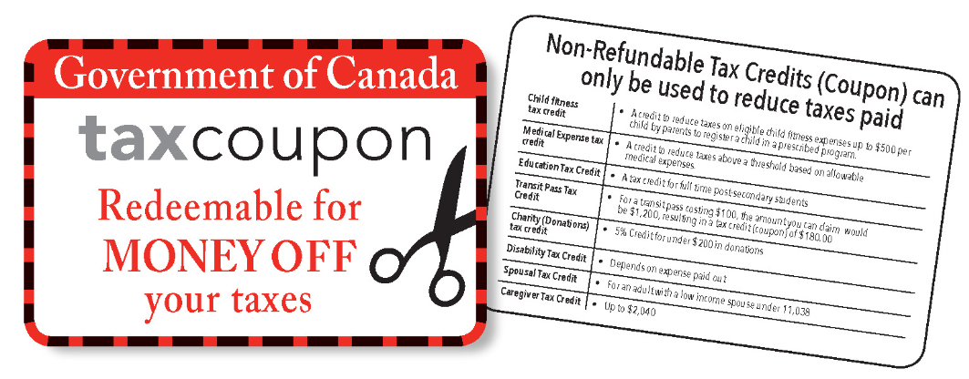
NON-REFUNDABLE TAX CREDITS
Money off for those who pay tax.
Worthless if your income is too low.

Slide 13

NON-REFUNDABLE TAX CREDITS
Money off for those who pay tax.
Worthless if your income is too low.

Slide 14

NON-REFUNDABLE TAX CREDITS
Money off for those who pay tax.
Worthless if your income is too low.

Slide 15
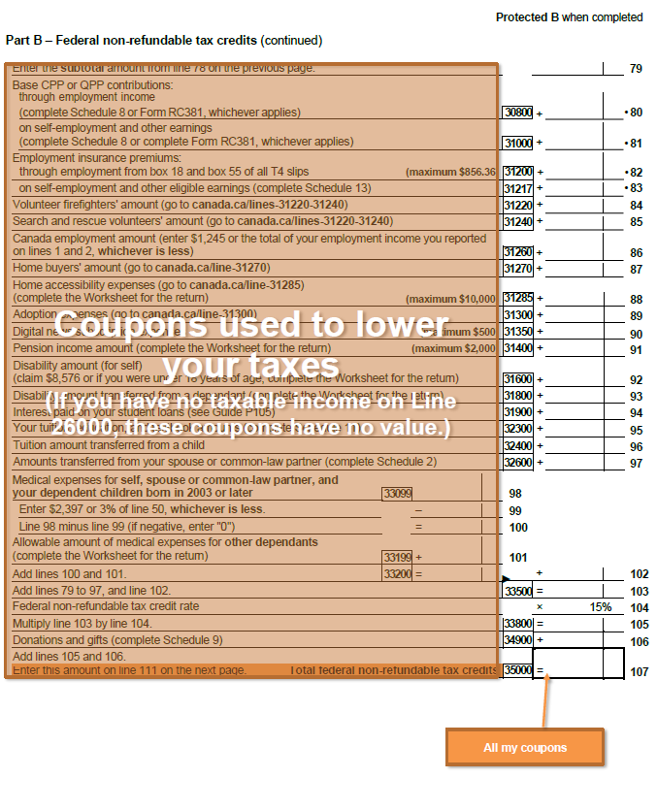
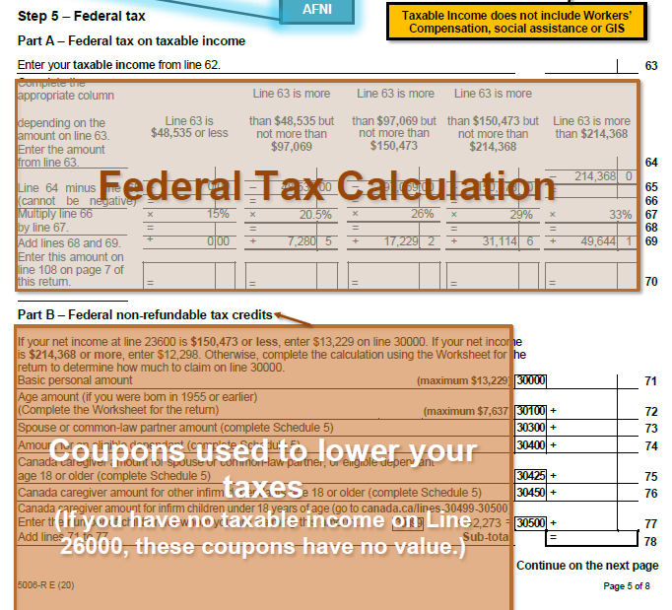

Slide 16
TAXABLE INCOME
How to reduce taxable income or get money back
Non-refundable tax credits
Refundable tax credits
Tax exemptions
Deductions
Entitlements
Understanding the system: A trip to the grocery store

Slide 17
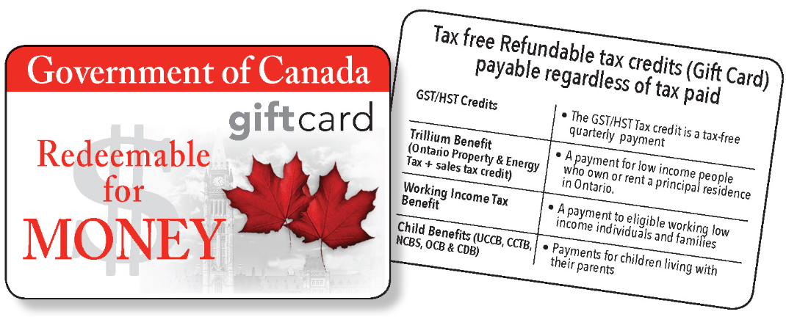
REFUNDABLE TAX CREDITS
A ‘gift card’ you can redeem for money

Slide 18
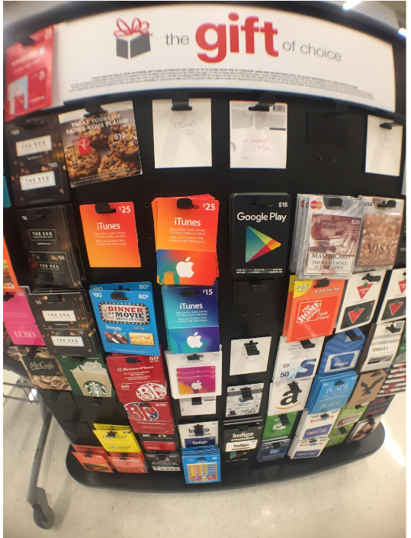
REFUNDABLE TAX CREDITS
A ‘gift card’ you can redeem for money

Slide 19
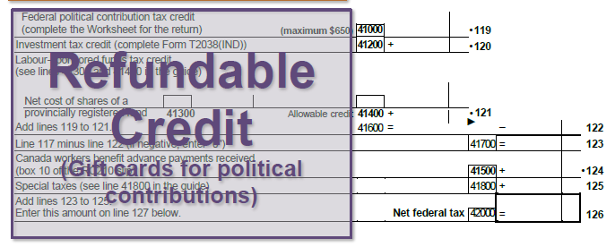
Page 7 of 8 in the income tax form

Slide 20
TAXABLE INCOME
How to reduce taxable income or get money back
Non-refundable tax credits
Refundable tax credits
Tax exemptions
Deductions
Entitlements
Understanding the system: A trip to the grocery store

Slide 21
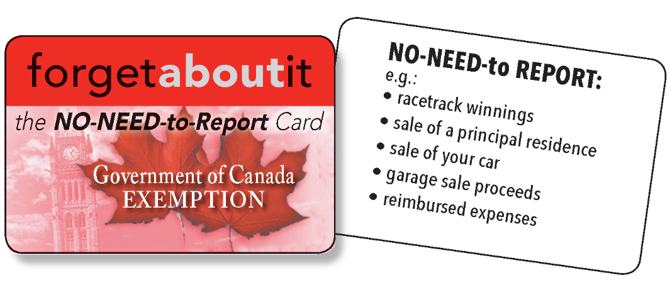
TAX EXEMPTIONS
The ‘forget about it’ card – you don’t have to report exempted money.

Slide 22
TAXABLE INCOME
How to reduce taxable income or get money back
Non-refundable tax credits
Refundable tax credits
Tax exemptions
Deductions
Entitlements
Understanding the system: A trip to the grocery store

Slide 23
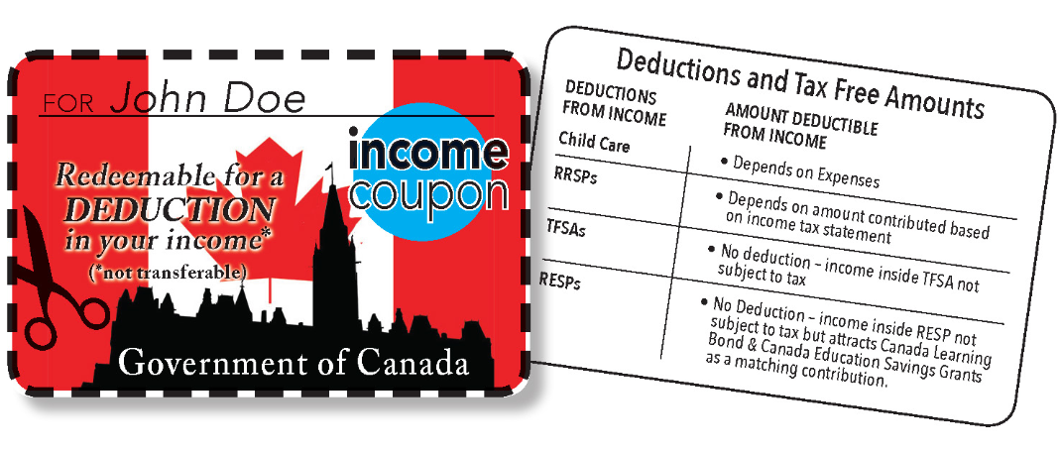
DEDUCTIONS AND TAX-FREE AMOUNTS
A special personalized “coupon”

Slide 24
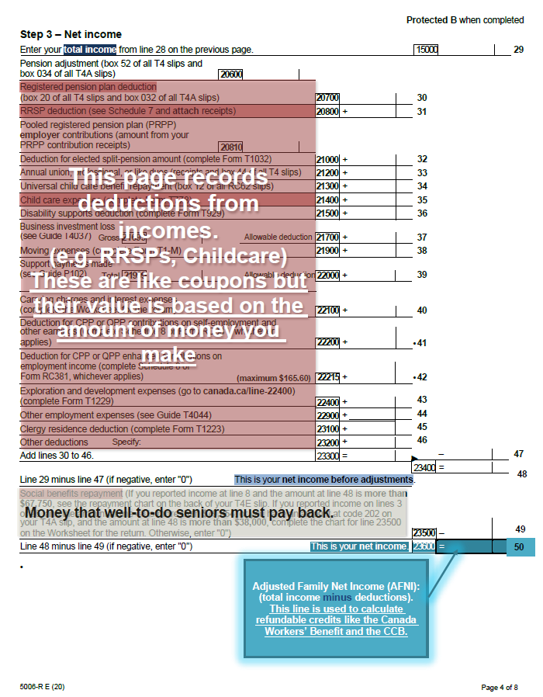

Slide 25
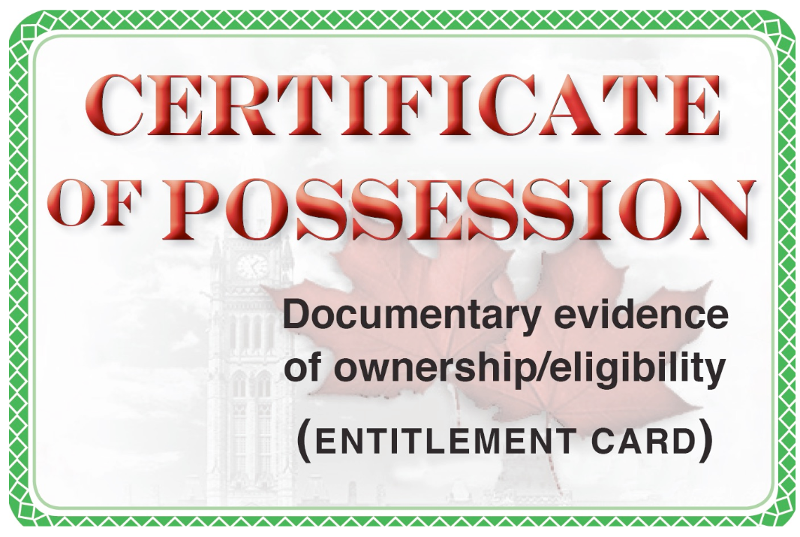
DEDUCTIONS AND TAX-FREE AMOUNTS
A special personalized “coupon”

Slide 26
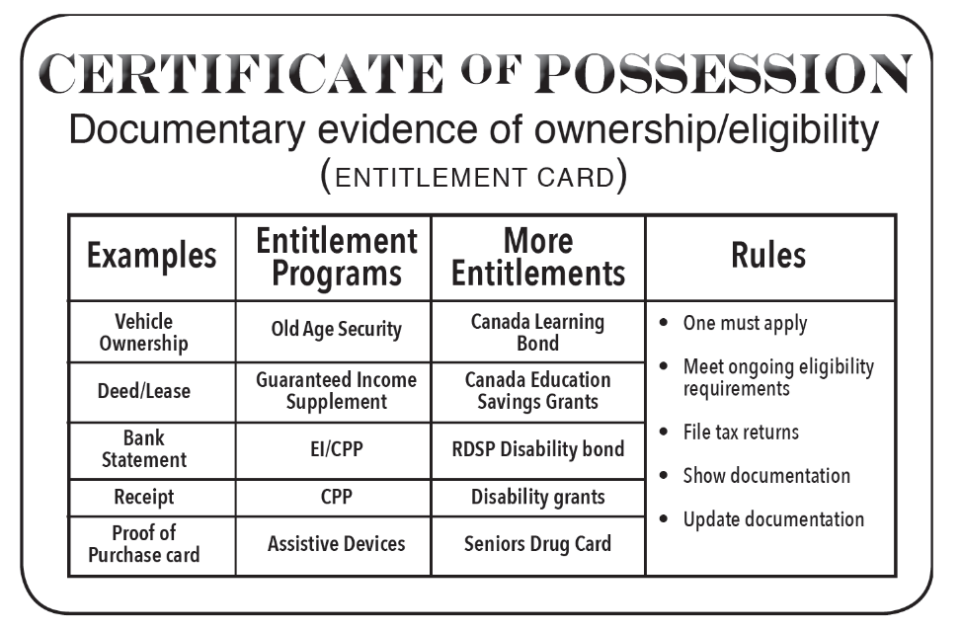
DEDUCTIONS AND TAX-FREE AMOUNTS
A special personalized “coupon”

Slide 27
TAXABLE INCOME
How to reduce taxable income or get money back
Non-refundable tax credits = Coupon
Refundable tax credits = Gift card
Tax exemptions = Forget about it
Deductions = Specialized coupon; everyone different
Entitlements = You own it; it’s yours
Tax refund = Combination of refundable and non-refundable credits (gift cards and coupons)
Putting it all together

Slide 28
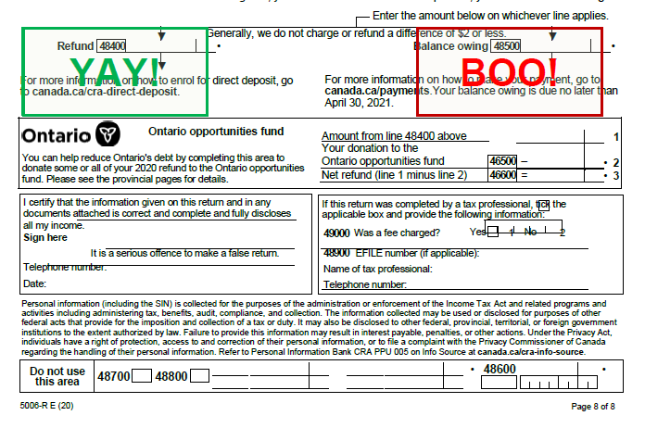

Slide 29
Thank You!
Questions

