Slide 1
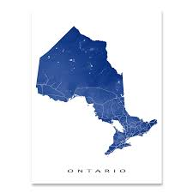


RETIRING ON A LOW INCOME
NEW PRESENTATION 2026
What do seniors get? Module 1
8 May 2026
John Stapleton
Photo by BDS.Photo on Unsplash

Slide 2
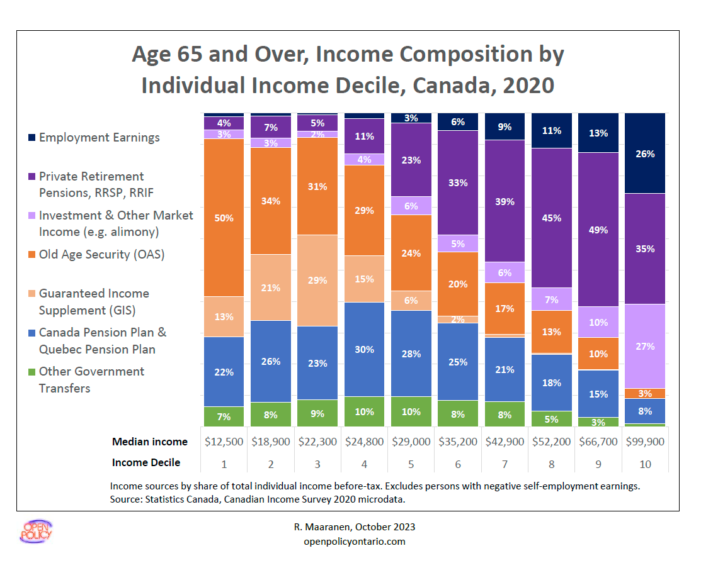

Slide 3
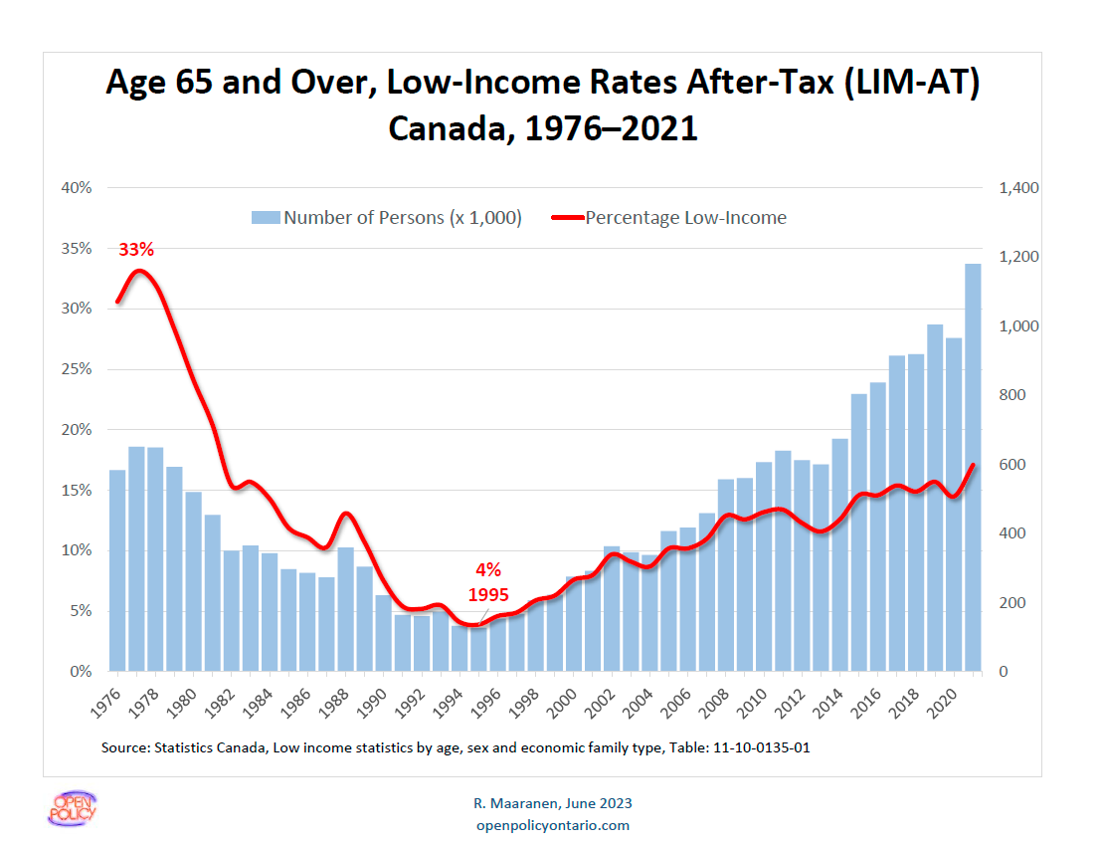
Notes:
For population age 65+, the low-income rates using LIM-AT reached its peak in late 1970s and dropped to the lowest point in 1995.
Currently, the low-incomes rates is around half of the level of the peak, while the actual account of persons in low income reaches its peak since late 1970s.

Slide 4
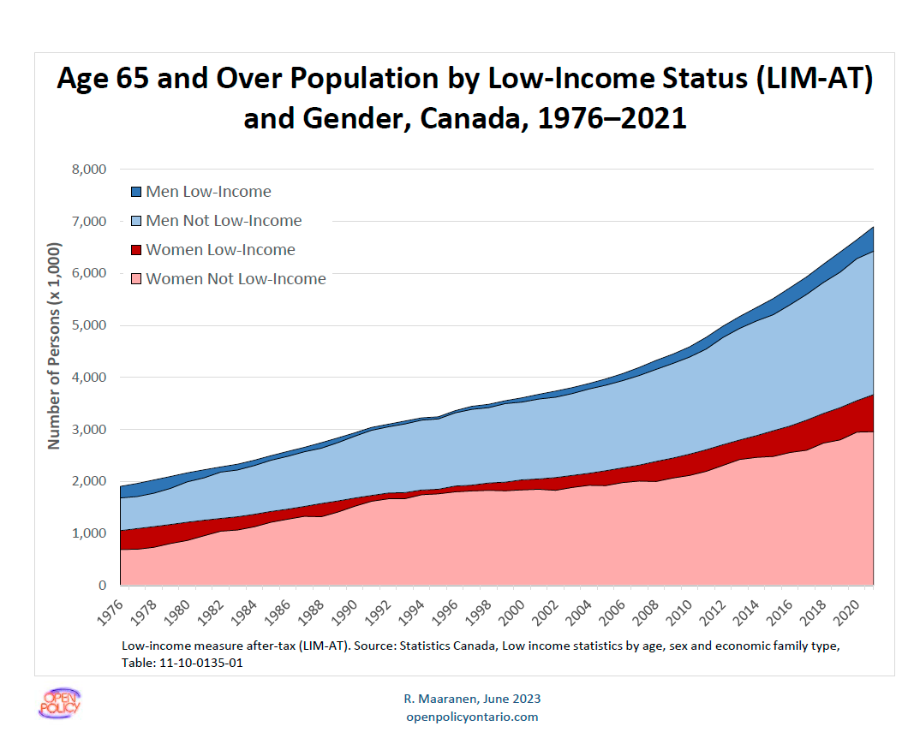

Slide 5
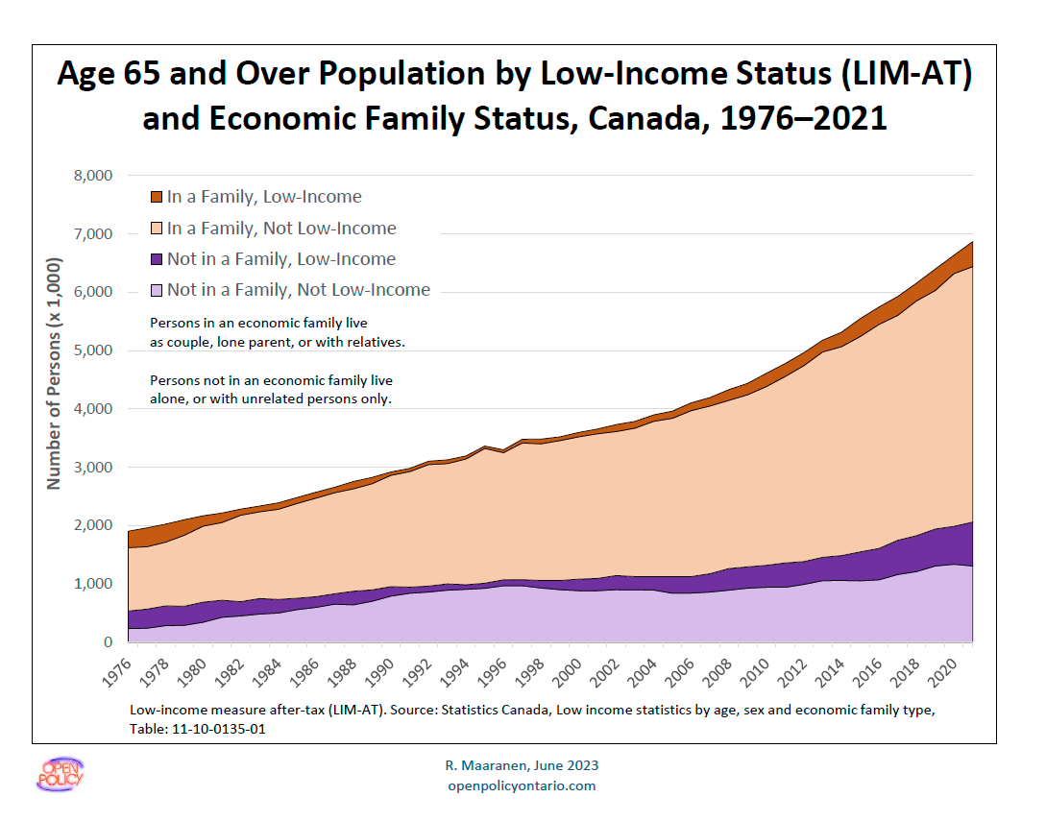

Slide 6
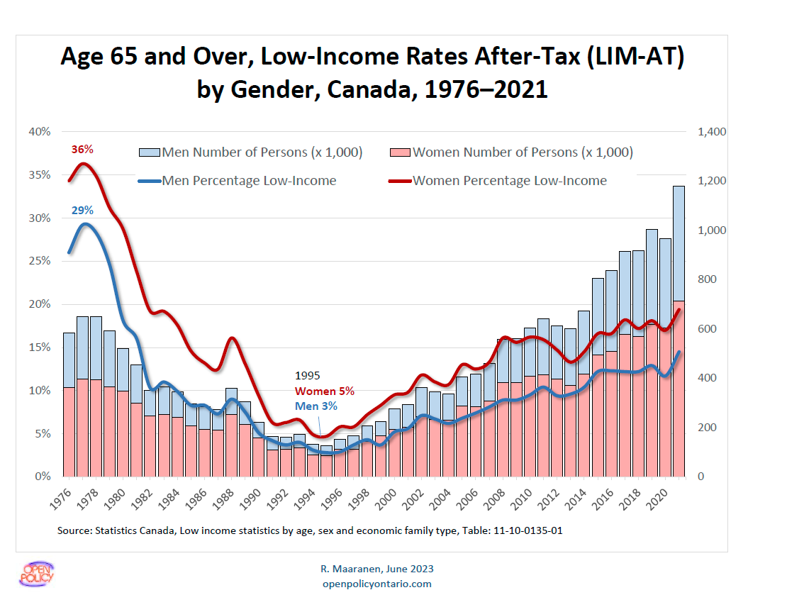
Notes:
This chart break down the previous chart by gender groups.
Women’s group constantly having higher low-income rates and higher count of seniors with low-income than men’s group,

Slide 7
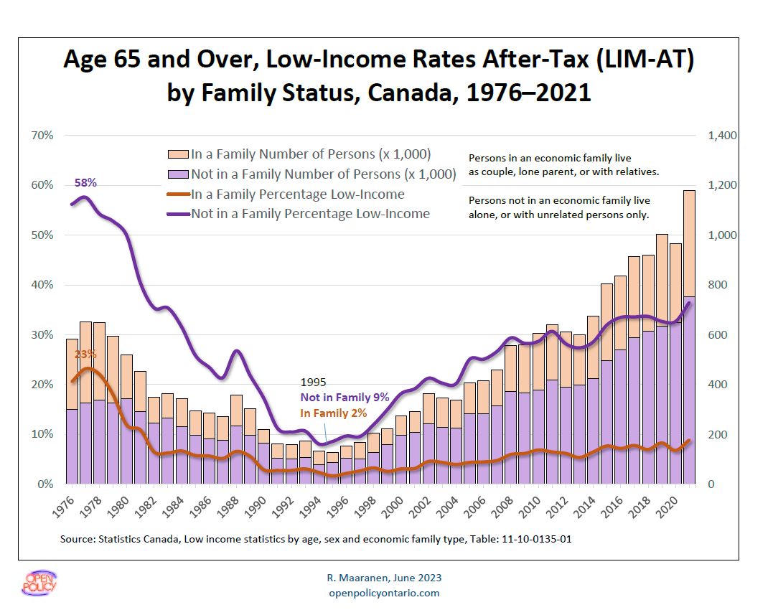
Notes:
This chart break down the chart on slide 35 by family status.
Seniors not in a family constantly having higher low-income rates and count of seniors with low-income than seniors living in a family.

Slide 8
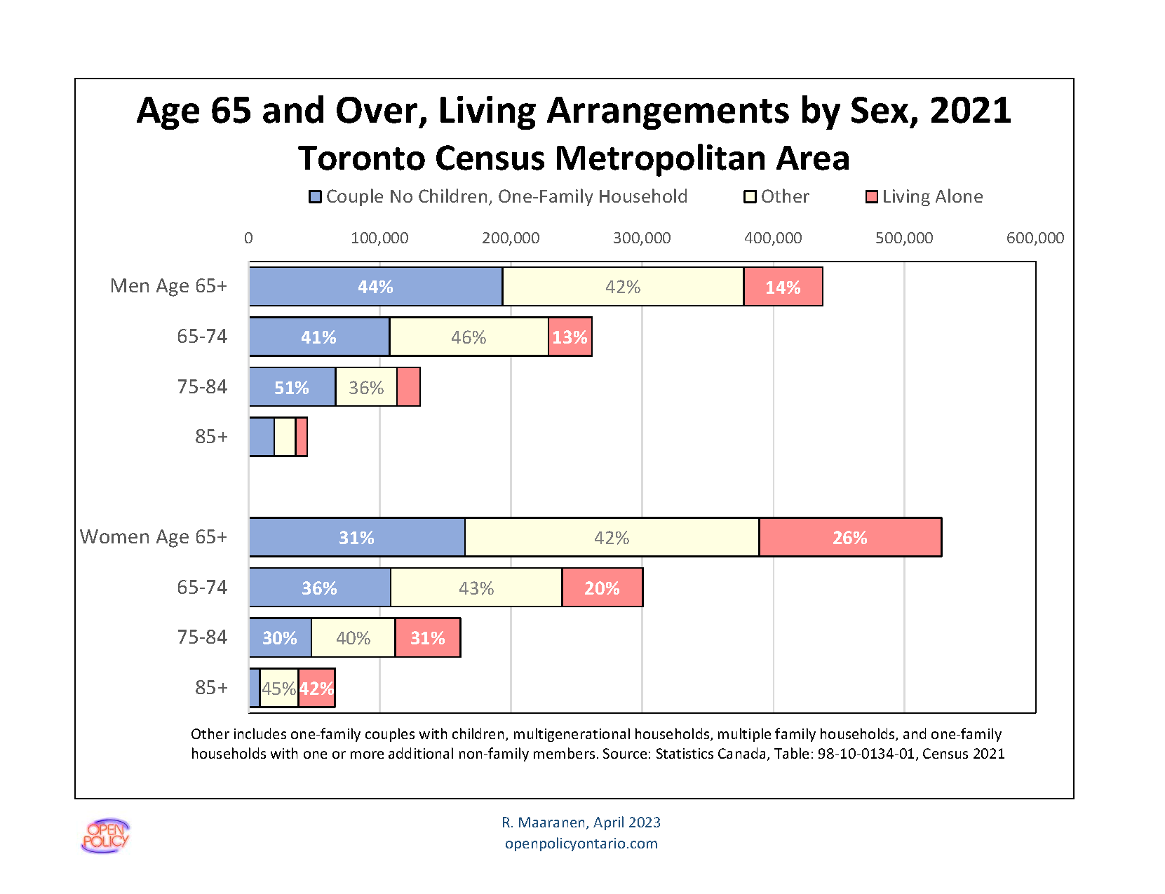
Non-Family 2 or More: People living with others not part of the extended family
Notes:
In both gender groups:
the likelihood of living with extended families stays roughly the same throughout age 65 to 85+
The likelihood of living alone increases with age.
Males age between 75 and 84 as well as females age between 65 and 74 are more likely to live as couple with no children than other age groups.

Slide 9
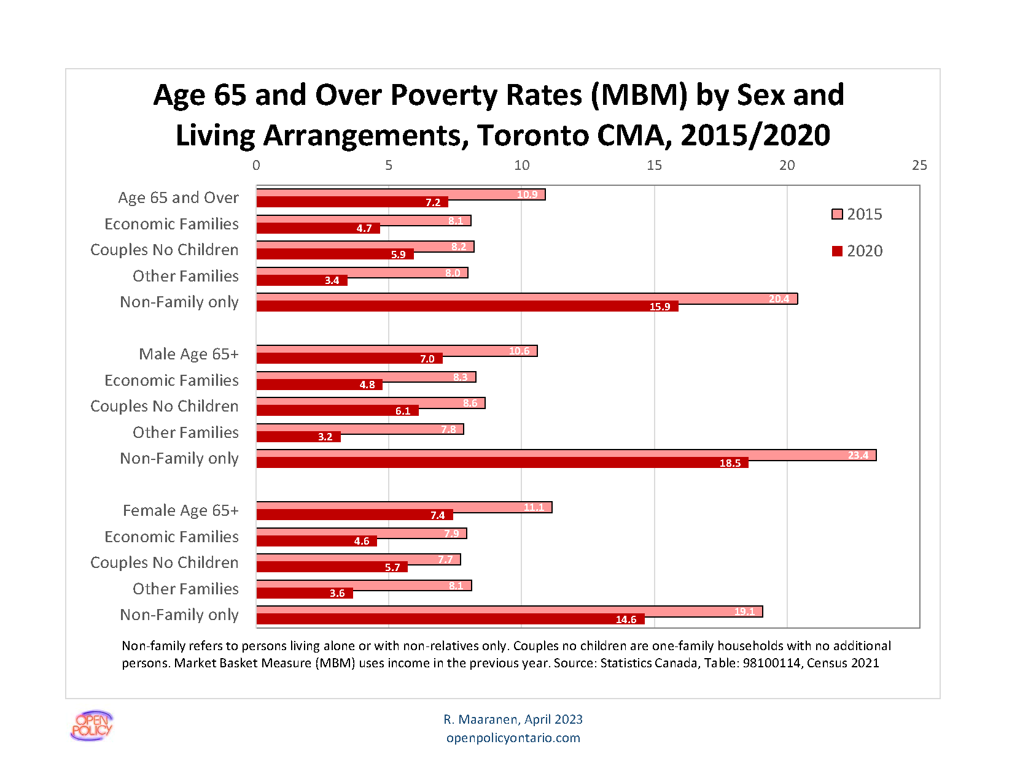
Notes:
For both gender groups, seniors living with non relatives only have the highest poverty rates.
Across all family types and gender groups, there’s a decrease of poverty rates since 2015.

Slide 10
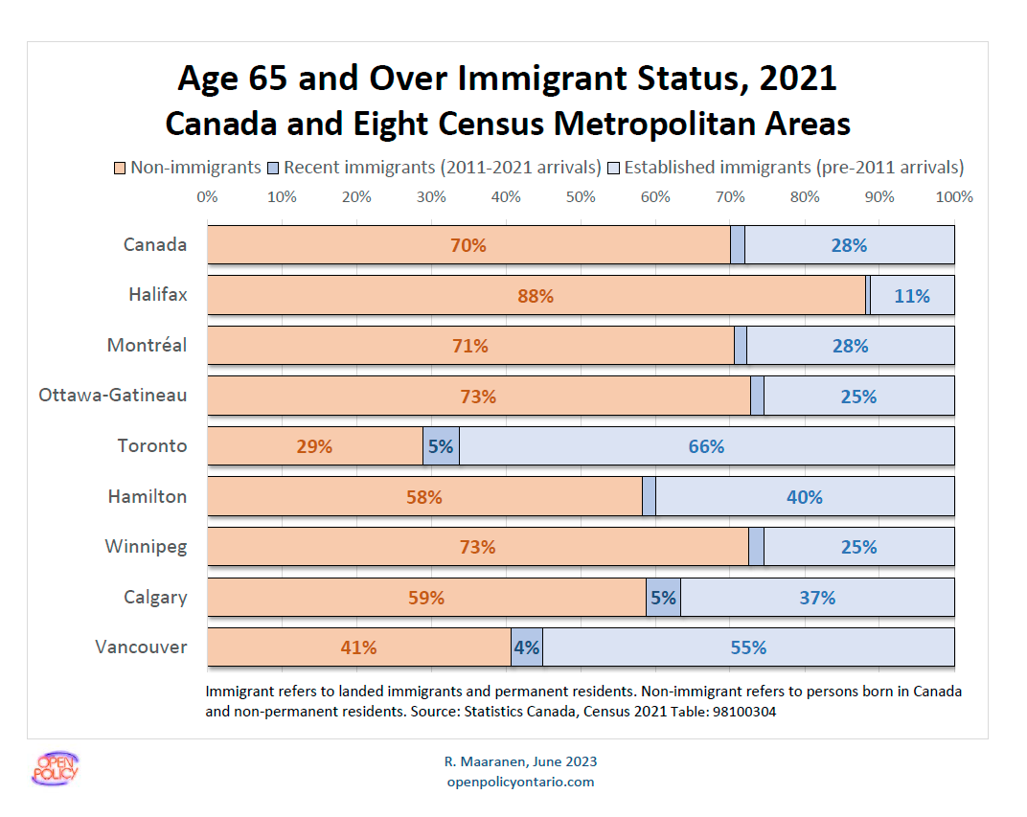
Notes:
Toronto and Vancouver have the first and second largest portions of seniors who are immigrants (including recent and established immigrants): 71% and 59%.
Toronto’s is significantly higher than Vancouver’s.
Halifax has the smallest portion: 12%
Toronto and Calgary have the largest portions of recent immigrants of their CMA population: 5% each.

Slide 11
New: 2022 - 2026
Higher OAS for 75+: 10% increment : $808.45 a month $74.23 higher than for those 65-74
Indexation –July 1, 2024– significant increases with CPI
No Indexation April to June 2024 and January to March 2025
Small increase for January 2026
GAINS $90 a month 2025-26 (Couples $180 a month)
and now indexed to CPI
Minimum wage increased to $17.60 on October 1, 2024 - $17.60 October 2025

Slide 12
WHAT SENIORS GET IN ONTARIO, MONTHLY
Program
How does it work?
Monthly Benefit
Canada Pension Plan (CPP)
Old Age Security (OAS)
Guaranteed Income Supplement (GIS)
Guaranteed Annual Income System (GAINS),Ontario only; Refundable Credits
Income from savings
Private pensions
Earnings
If you paid in, you can get a pension.
Most people 65+ get this. There are also some benefits for low-income spouses not yet 65.
People with low incomes may get this.
If you are getting GIS but are still below the province’s minimum income, you get extra money.
Money you put in an RRSP or TFSA
A pension from where you worked
Money from working for wages or ‘other’
Age 60: $920
Age 65:$1,508
Age 65: $742.31
Age 65: $1,108.74 for singles
Age 65: $90 a month

Slide 13
WHAT DOES “LOW INCOME” MEAN?
Will you be eligible for OAS?
You will be low income if your yearly income
(not counting OAS!) is under:
Family picture when you are age 65
Single person
Couple
- Both getting Old Age Security (OAS pension)
Couple
- Only one partner getting OAS
- Other partner is under 65
Couple
- One partner getting OAS
- Other partner is 60-64 and getting the Allowance
$22,488
$29,712
$53,904
$41,616

Slide 14
GIS TAX-BACK
a.k.a. GIS Reduction
The tax-back is 50% on GIS and (a further 25% on the GIS supplement for a real rate of 59% - 50% on earnings only) on all net income from:
RRSP cash outs
Pensions
CPP
Investment INCOME
Wage Earnings after $5,000 a year
(50% recovery only)
Honorariums
Note: Income from OAS does not affect the amount of GIS you receive
What happens to your GIS when you earn other income?

Slide 15
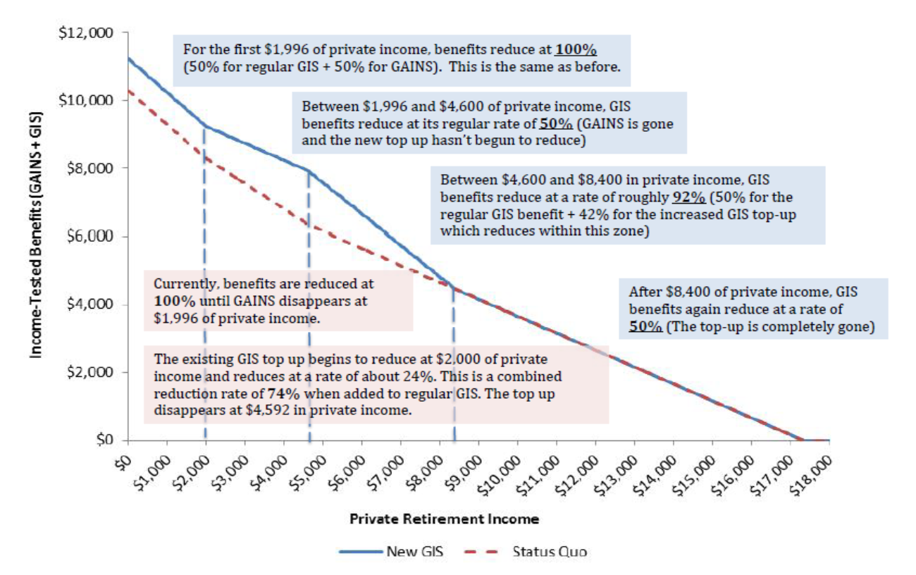
Why and Where the GIS clawback exceeds 50% to an overall 59% for non-earners
+25% in GIS supplement zone (2016 graph)

Slide 16
CHANGES IN 2020
Good news
Earnings exemption went to $5,000 from $3,500
Extended to self-employed
Tax-back/clawback rate reduced to 50% overall, allowing more seniors to earn more money before losing GIS
Reduces overall recovery rate from 75% in GIS supplement zone to 50% for earners
You can keep more of your GIS when you earn income

Slide 17
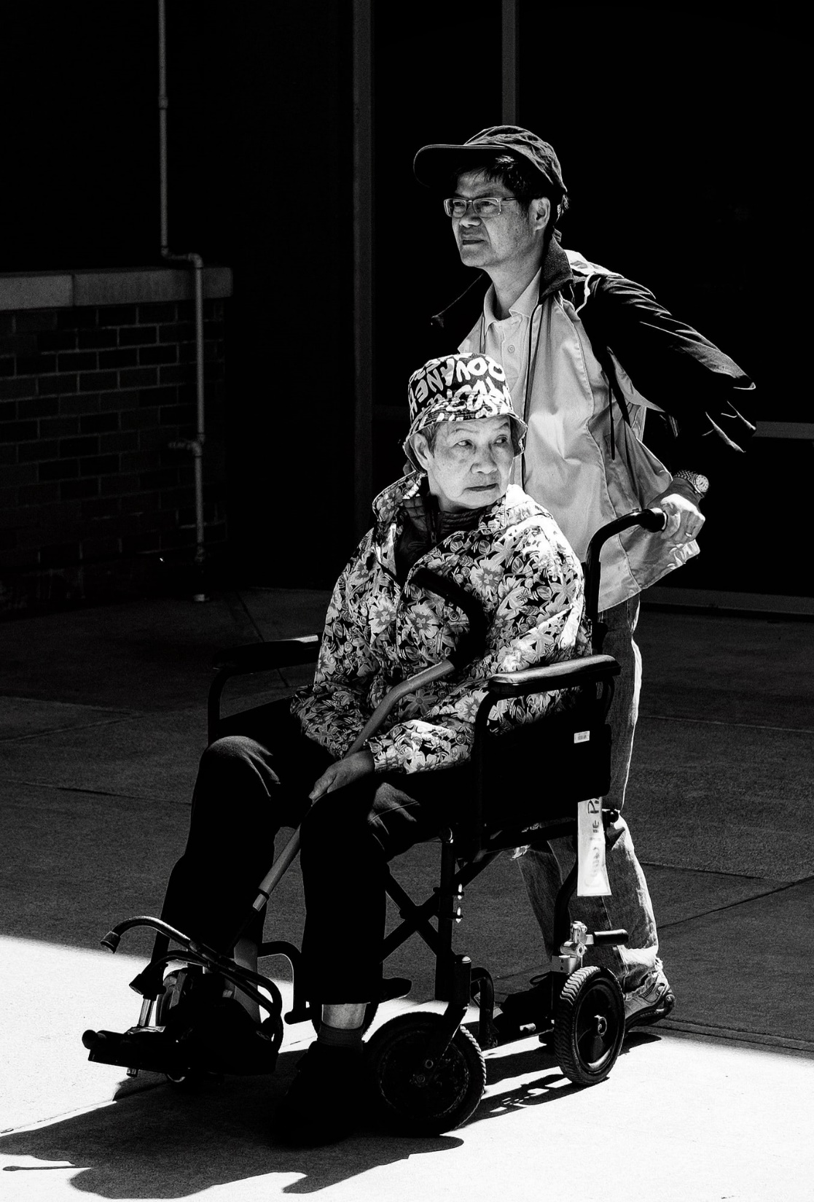
Photo by Paul Stickman on Unsplash
TINA’S STORY
An example
Single mother receives social assistance from age 18 to 30
Went back to school
Worked as a part-time nurse’s assistant from age 30 to 50
Became disabled with MS and received Ontario Disability (ODSP)
Now she is turning 65

Slide 18
WHAT WILL TINA HAVE AT AGE 65?
Source
Average monthly income
Max payout p/m
Canada Pension Plan (CPP)
Old Age Security (OAS)
Guaranteed Income Supplement (GIS)
Guaranteed Annual Income System
Income from savings
Private pensions
Refundable tax credits
Total average monthly income
$364
$742.31
$766.93.(why?)
$0 (her net income for GIS is over $4,000)
$10
$90
$198
$2,171.24 x 12 =
$1,433
$742.31
$1,108.74
$90.00
Total yearly income: $26,054.88

Slide 19
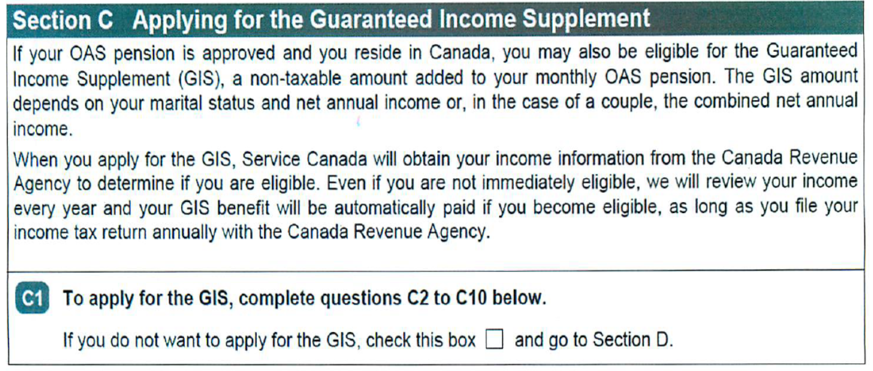

New OAS/GIS FORM
New starting 2019: If you want GIS, don’t tick the box!
DON’T TICK THE BOX
LEAVE THE BOX TO THE TICKS!!!
Image by Drawn to the Sea

Slide 20
New OAS/GIS FORM
A tick box on the OAS/GIS form:
If you are low income – Don’t tick the box
If you are unsure – Don’t tick the box
No need to worry… Don’t tick the box
Fill it out – answer all questions
File your taxes
New starting 2019: If you want GIS, don’t tick the box!

Slide 21
APPLICATION FOR THE
GUARANTEED INCOME SUPPLEMENT
In Ontario
For postal codes beginning with "L, M or N”
Service Canada
PO Box 5100 Station D Scarborough ON
M1R 5C8
CANADA
For postal codes beginning with "K or P”
Service Canada
PO Box 2013 Station Main Timmins ON
P4N 8C8
CANADA

Slide 22
REVIEW
What forms of income do not reduce GIS?
Old Age Security (OAS)
Tax Free Savings Accounts (TFSA) cash outs
RDSP withdrawals
Refundable Tax Credits you get with your income tax refund – child benefits, Trillium, Working Income Tax Benefits, GST credits
GIS not affected

Slide 23
Thank You
Questions

