Slide 1
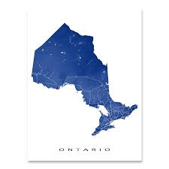


RETIRING ON A LOW INCOME
NEW PRESENTATION 2026
Protecting low-income retirement income – navigating the parallel universe of low-income retirement: Module 3
John Stapleton
Photo by BDS.Photo on Unsplash

Slide 2
PROTECTING A LOW INCOME RETIREMENT
Will the government tell you about everything you are entitled to?
Should everyone apply for OAS?
Should you work after 65?
Should you take early CPP?
Should you buy RRSPs?
Should you save in a TFSA?
Can you leave Canada and collect?
What can you do to protect your money?

Slide 3
PROTECTING A LOW INCOME RETIREMENT
Will the government tell you about everything you are entitled to?
Should everyone apply for OAS?
Should you work after 65?
Should you take early CPP?
Should you buy RRSPs?
Should you save in a TFSA?
Can you leave Canada and collect?
What can you do to protect your money?

Slide 4



WILL THE GOVERNMENT TELL YOU ABOUT EVERYTHING YOU ARE ENTITLED TO? DON’T COUNT ON IT
CPP and OAS: get application forms from Service Canada
Don’t Tick the box for GIS on the OAS form
They will tell you if you qualify for GAINS
File your tax returns to make sure you get other credits and benefits ...and your GIS will be renewed automatically each July!

Slide 5
PROTECTING A LOW INCOME RETIREMENT
Will the government tell you about everything you are entitled to?
Should everyone apply for OAS?
Should you work after 65?
Should you take early CPP?
Should you buy RRSPs?
Should you save in a TFSA?
Can you leave Canada and collect?
What can you do to protect your money?

Slide 6

SHOULD EVERYONE APPLY FOR OAS?
Yes. Do it as soon as you approach age 65 if low income and eligible
Half are enrolled automatically & will receive a letter to this effect
Only apply if you don’t receive the letter...
Even if you have not been in Canada long, you may get some OAS
If you qualify for OAS and you have a low income, you qualify for some GIS
Photo by Ian Wetherill on Unsplash

Slide 7
PROTECTING A LOW INCOME RETIREMENT
Will the government tell you about everything you are entitled to?
Should everyone apply for OAS?
Should you work after 65?
Should you take early CPP?
Should you buy RRSPs?
Should you save in a TFSA?
Can you leave Canada and collect?
What can you do to protect your money?

Slide 8
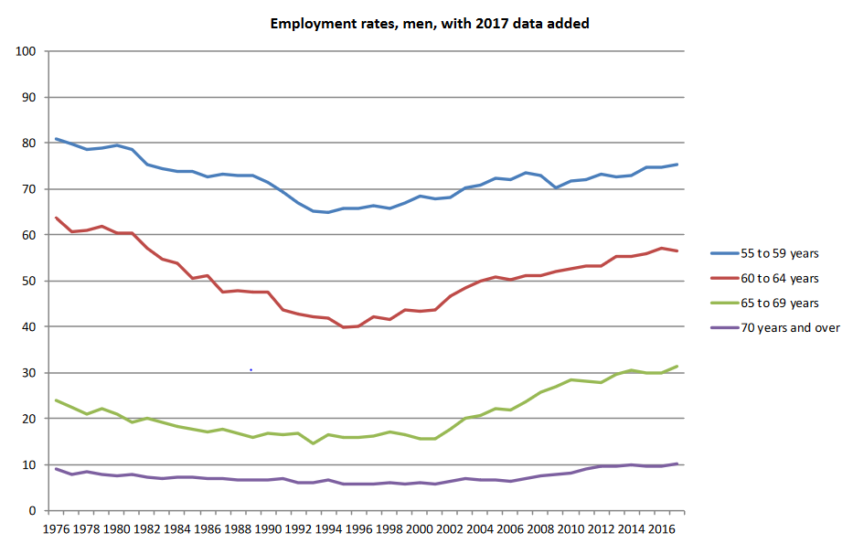
SHOULD YOU WORK AFTER 65?

Slide 9
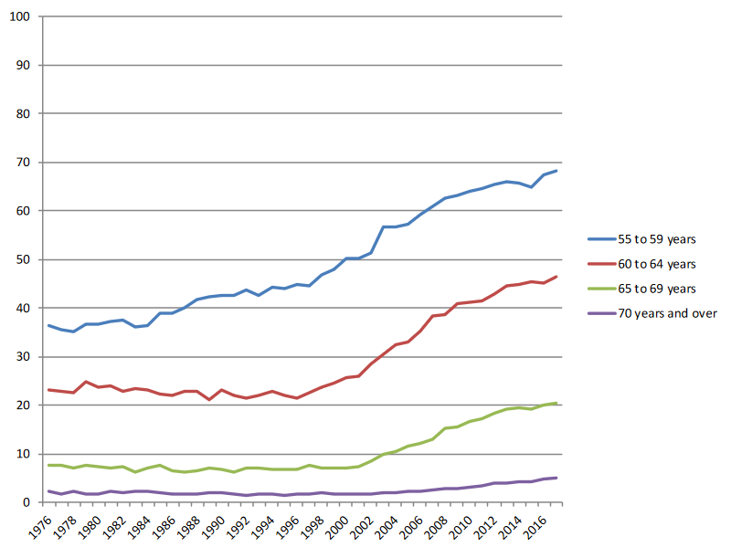
SHOULD YOU WORK AFTER 65?

Slide 10
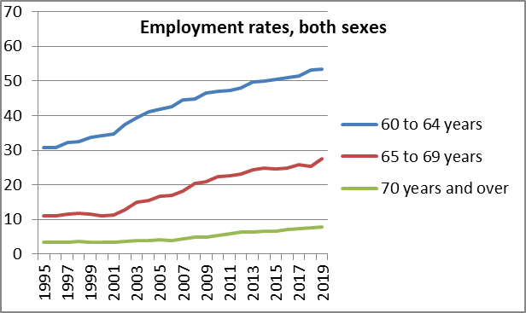
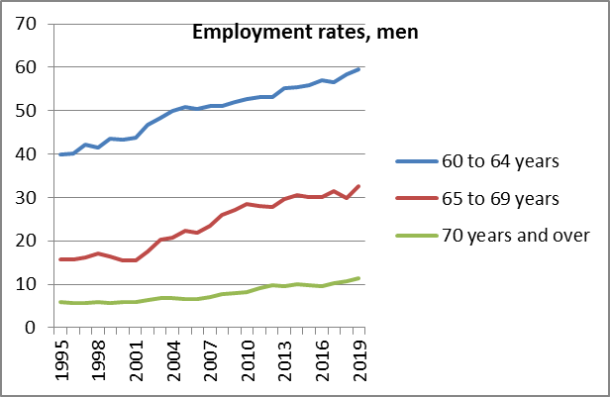
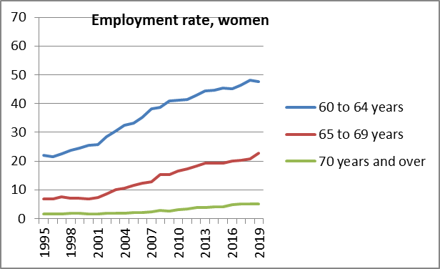

Slide 11
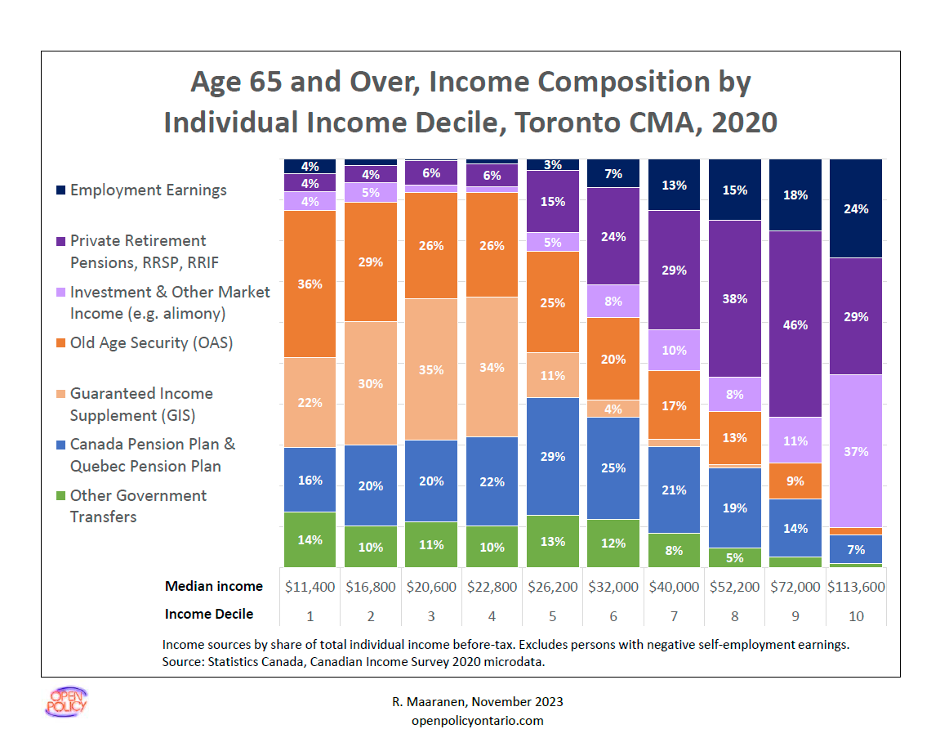

Slide 12
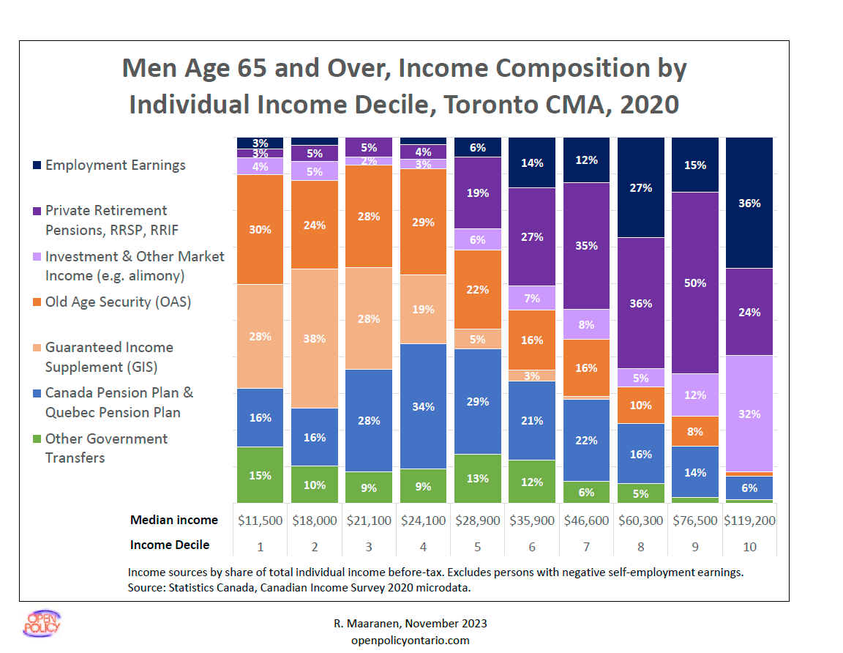

Slide 13
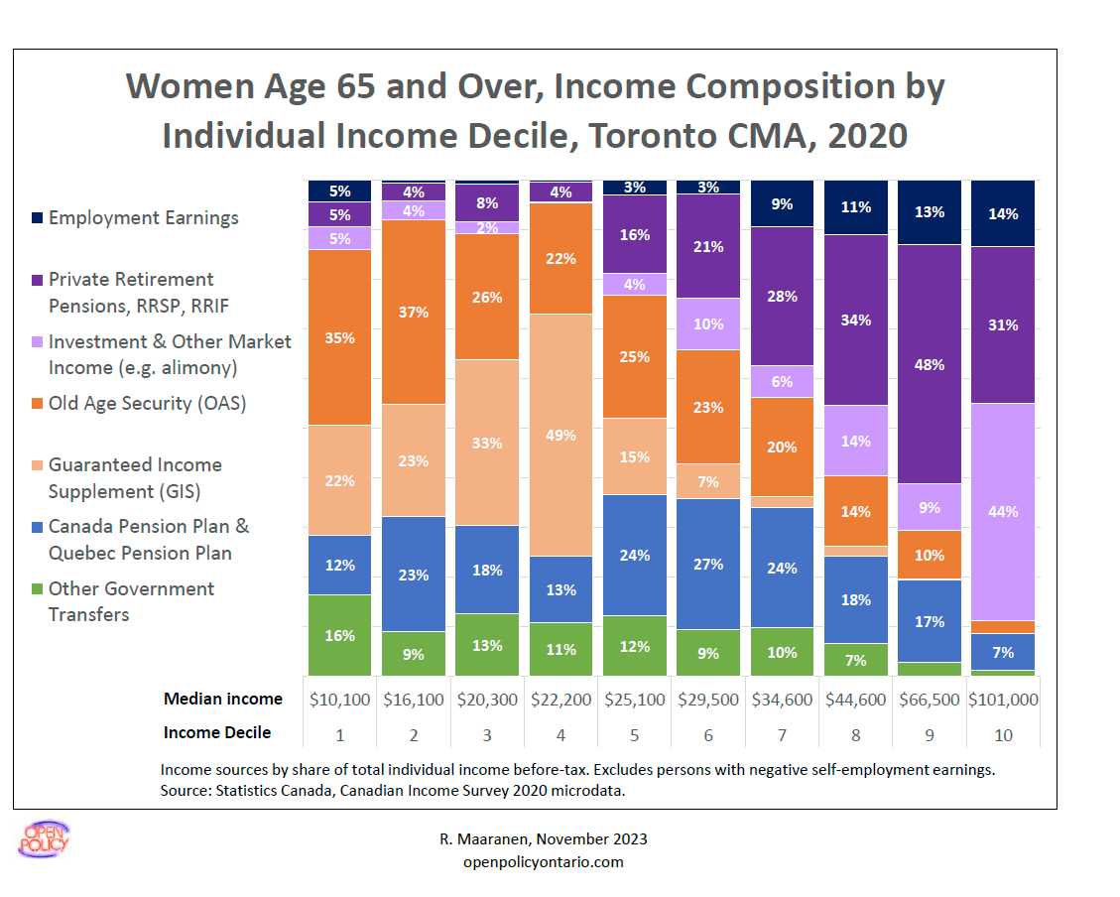

Slide 14
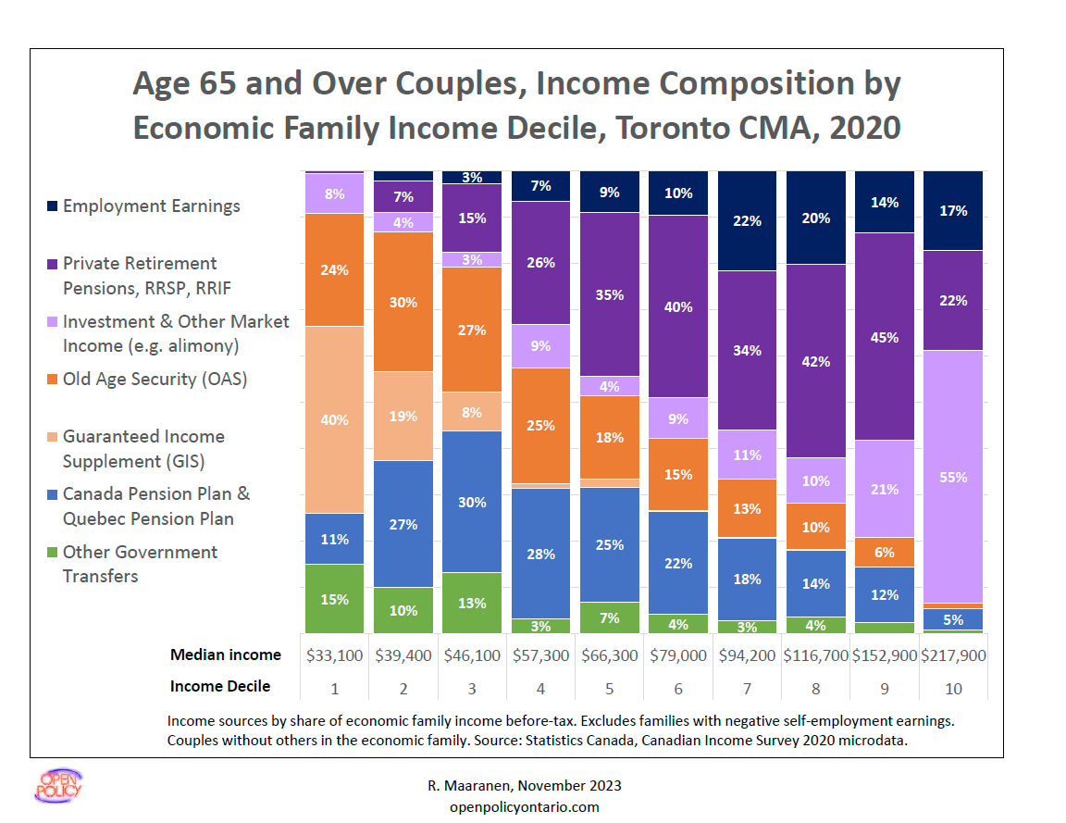

Slide 15
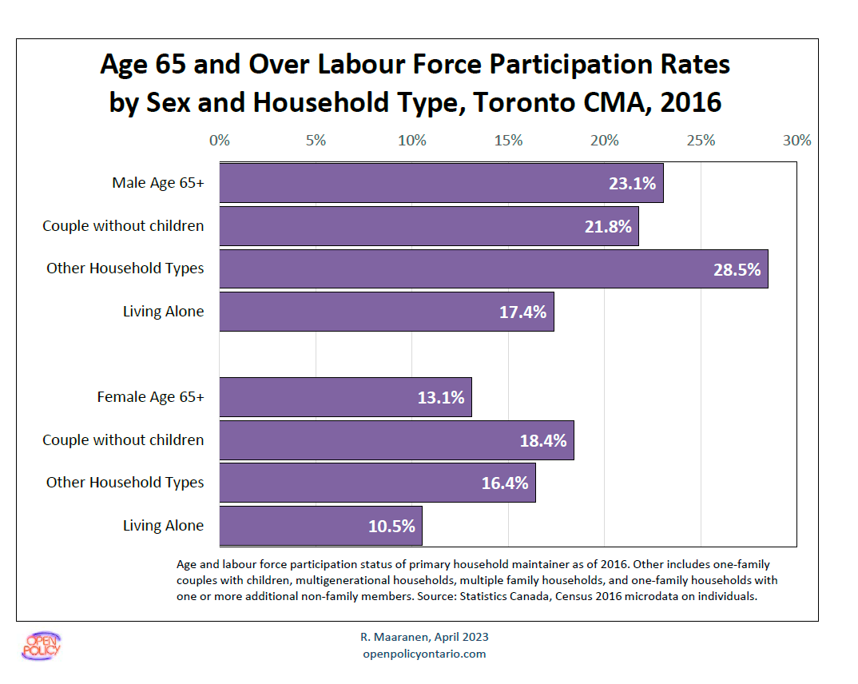
Notes:
Across all household types, males have higher labour force participation rates than females in population age 65+.
The highest labour participation rate for senior males is of Other Household Types, for senior females is of Couple without children.
In both male and female groups, seniors living alone are least likely to participate in the labour force.

Slide 16
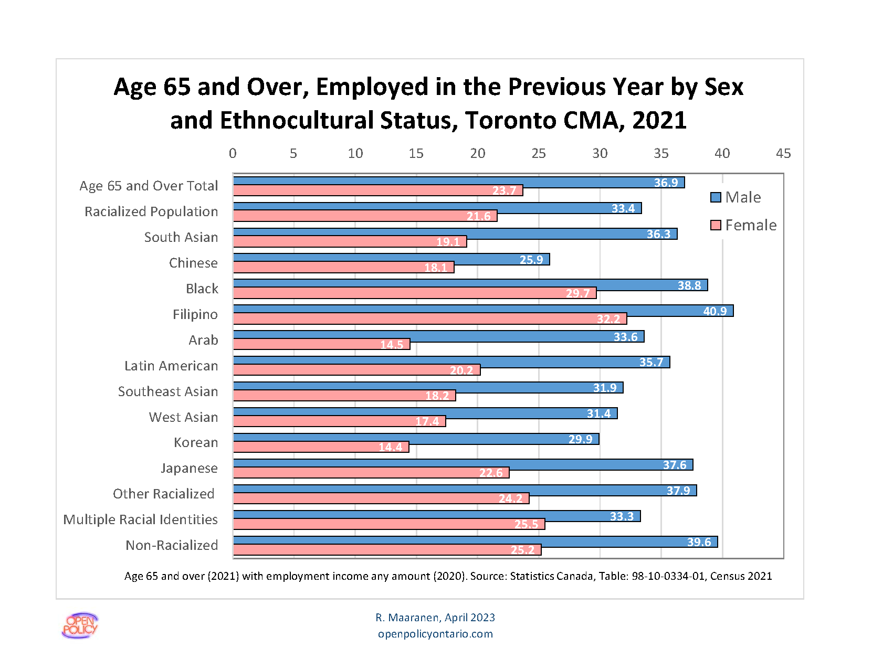
Notes:
Across all ethnocultural groups age 65+, senor males (36.9%) have higher labour force participation rates than senior females (23.7%).
In senior male group,
Filipino (40.9%) and Non-racialized groups (39.6%) have the first and second highest labour force participation rates
Chinese (25.9%) and Korean (29.9%) groups have the first and second lowest labour force participation rates.
In senior female group
Filipino (32.2%) and Black (29.7%) have the first and second highest labour force participation rates
Korean (14.4%) and Arab (14.5%) groups have the first and second lowest labour force participation rates

Slide 17

SHOULD YOU WORK AFTER 65?
ANY net income reduces the benefits that low-income seniors get except $5000 in net earnings
Low-income seniors get benefits from GIS and GAINS
Both get clawed back at 50% after you earn just $5000 (T4 slip)
GIS gets clawed back at 50% (nominal - 59% real) and GAINS at 25% after the 1st DOLLAR of any other kind of net income
Examples: Money you take from RRSP savings (T4RIF), or honoraria (T4A)
Photo by Mitchell Luo on Unsplash

Slide 18
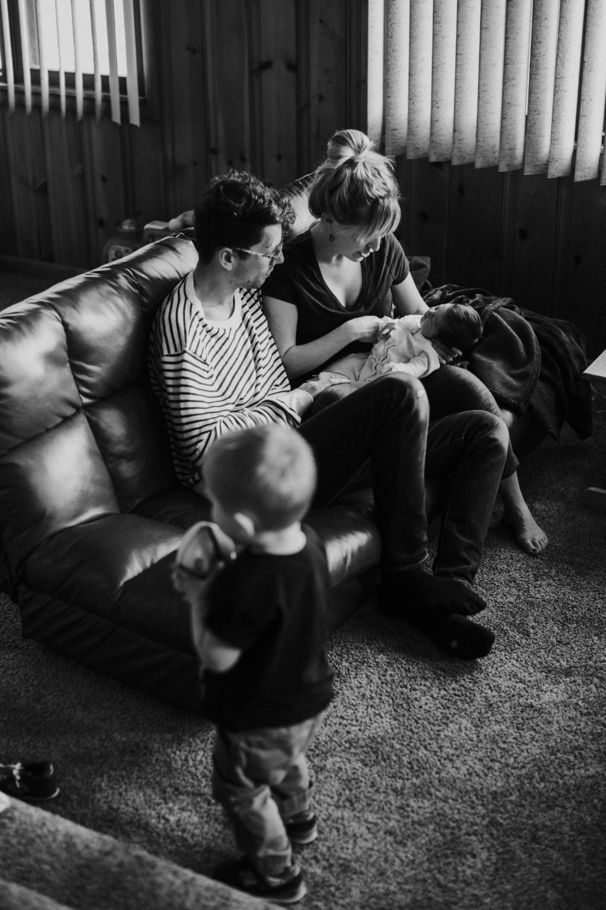

SHOULD YOU WORK AFTER 65?
The St. Patrick’s Day Rule or Family Day Rule
Minimum wage of $17.60 an hour
=$5000 or so by St. Paddy’s day
250 hours (7 weeks at 35 hours a week)
After that, every dollar is taxed back at 50% and 75% over some income zones
Think about working after St. Patrick’s Day or Family Day if you are low income!
Photo by Brytny.com on Unsplash

Slide 19

Photo by Paul Stickman on Unsplash
PHILIP’S STORY
An example
A near-senior living on $1,000 a month from ODSP
Volunteers to speak for the Dream Team
Received $1,490 in honoraria
GAINS clawed back 50% (now 25%)
GIS clawed back 50% (real rate of 59%)
Phillip got nothing until he got beyond the GAINS-A clawback

Slide 20



SOLUTIONS FOR HONOURARIA
The T4A slip ‘trigger point’ is $500
Stop collecting honoraria at $499
Volunteer for another agency for next $499
Or, if it makes sense for you, reduce your taxable income by contributing to an RRSP. We get to this later….

Slide 21
PROTECTING A LOW INCOME RETIREMENT
Will the government tell you about everything you are entitled to?
Should everyone apply for OAS?
Should you work after 65?
Should you take early CPP?
Should you buy RRSPs?
Should you save in a TFSA?
Can you leave Canada and collect?
What can you do to protect your money?

Slide 22

SHOULD YOU TAKE EARLY CPP?
The usual age to take CPP is 65
Early CPP is age 60. It is a little less money, but you may need it now
If you are on social assistance, don’t take it early. Your social assistance will be clawed back
After age 65 you likely won’t have to worry about the OW or ODSP clawback
Photo by Ian Wetherill on Unsplash

Slide 23

The Parallel Universe of Low- Income Retirement
Photo by Jeremy Perkins on Unsplash

Slide 24

THE PARALLEL UNIVERSE
Why is retirement different for low-income people?
Most middle and high-income people have less income after they stop working
Most low-income people have more
Most middle and high-income people pay less tax after they retire
Most low-income people don’t pay tax
But they might have to when they start getting CPP and OAS
Photo by Jeremy Perkins on Unsplash

Slide 25
PROTECTING A LOW-INCOME RETIREMENT
Will the government tell you about everything you are entitled to?
Should everyone apply for OAS?
Should you work after 65?
Should you take early CPP?
Should you buy RRSPs?
Should you save in a TFSA?
Can you leave Canada and collect?
What can you do to protect your money?

Slide 26

SHOULD YOU BUY RRSPs?
Only when your CPP, OAS and other income means you might have to pay tax
An RRSP can increase your GIS as RRSP contributions can increase GIS (but withdrawals will reduce it)
Your lower taxable income might increase your GIS
You can buy RRSPs from age 65 to 71
Photo by Artem Beliaikin on Unsplash

Slide 27

RRSP CASH-IN BEFORE 65
You may pay less tax in retirement by cashing in your RRSP early
Tax withholding on RRSP withdrawals:
10% up to $5,000
20% from $5,000 to $15,000
30% over $15,000
Refunded if you don’t pay tax
But even if you do pay tax, it’s still less than the 50% and 75% reduction on GIS + tax payable AFTER age 65!
Photo by Jeff Sheldon on Unsplash

Slide 28
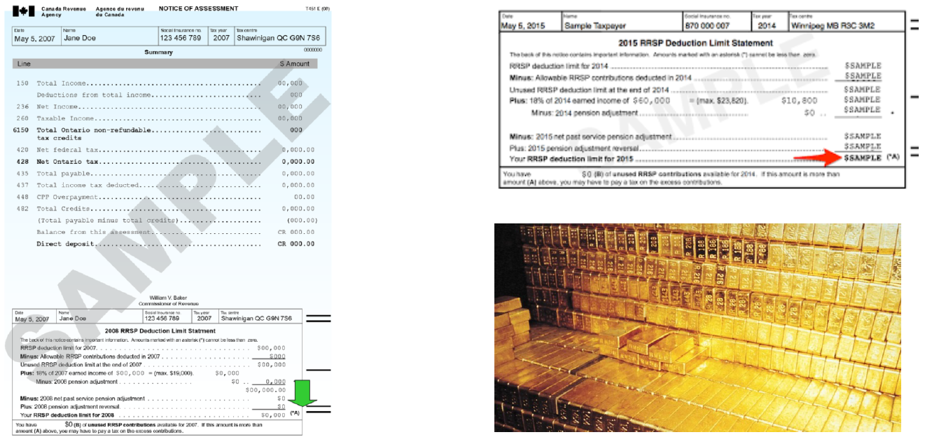
YOUR NOTICE OF ASSESSMENT IS A GOLD MINE

Slide 29




TAXABLE INCOME BEFORE AND AFTER RETIREMENT
More sources of income are taxable for low income people after retirement
Before age 65
After age 65
Earnings
Ontario Works
Ontario Disability Savings Plan (ODSP)
Pain and suffering awards
Some settlements
Earnings
Canada Pension Plan (CPP)
Old Age Security (OAS)
RRSP cash-outs
Private pensions
Investment Income

Slide 30
SHOULD YOU BUY RRSPs?
Registered Retirement Savings Plans are for people who pay taxes
They help to pay less tax now, but you pay it when you take the money out
That makes sense for higher-income people
It makes no sense for low-income people until they start getting CPP and OAS
Photo by Artem Beliaikin on Unsplash

Slide 31
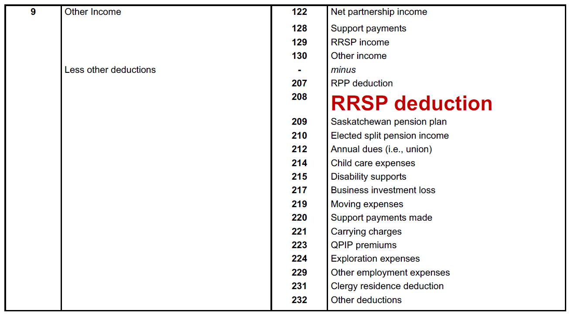
NET INCOME FOR GIS PURPOSES

Slide 32
PROTECTING A LOW-INCOME RETIREMENT
Will the government tell you about everything you are entitled to?
Should everyone apply for OAS?
Should you work after 65?
Should you take early CPP?
Should you buy RRSPs?
Should you save in a TFSA?
Can you leave Canada and collect?
What can you do to protect your money?

Slide 33
SHOULD YOU SAVE IN A TFSA?
Tax Free Savings Accounts (TFSAs) are always a good way for low-income people to save
The interest you earn can’t be taxed
You don’t have to take it out until you want to
Money in a TFSA can’t be clawed back
Photo by Artem Beliaikin on Unsplash

Slide 34

SHOULD YOU SAVE IN A TFSA?
You can prevent the RRIF bear hug …
Question: When you turn 71, what happens to a TFSA?
Answer: Nothing! You take it out when you want – everything tax free
Question: When you turn 71, what happens to an RRSP?
Answer: Your RRSP turns into a RRIF and you go into the RRIF ‘bear-hug’ where you must take out an increasing % per year from 5.28% to 20%. All of it is taxable!
Photo by Artem Beliaikin on Unsplash

Slide 35
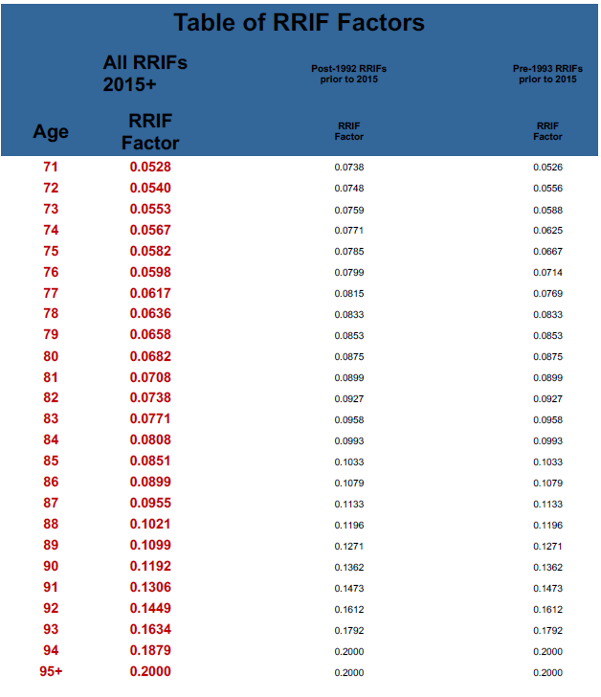
MANDATORY RRIF WITHDRAWLS
Starting at age 71

Slide 36
Thank You!
Questions

