Slide 1

RentSafe in Owen Sound
Landlord & Tenant Survey Findings
Corporate Services Committee for the City of Owen Sound
November 14, 2024
Presented by Seana Moorhead on behalf of the
RentSafe Owen Sound Collaborative
The City of Owen Sound is situated on the traditional territory of the Anishinabek Nation: The People of the Three Fires known as Ojibway, Odawa, and Pottawatomie Nations.

Slide 2

Introduction to the
RentSafe Owen Sound Collaborative
  The RentSafe Owen Sound Collaborative is a group of organizations and community partners working together towards the goal of safe and healthy homes for all
  Catalyzed by the RentSafe EquIP research project in Owen Sound (2016-2019) that focused on building meaningful interaction among people from diverse sectors.
  Launched at the final RentSafe EquIP research event (November 2019) by community members and agency partners seeking to continue to work together to promote safe and healthy homes for all.
  Linked to province-wide RentSafe initiative (2014-present) and supported by Canadian Partnership for Children’s Health and Environment (CPCHE)
RentSafe: Connecting people across sectors towards healthy housing for all
Notes:
to (1) better understand the causes and consequences of housing inadequacy as seen from multiple viewpoints, and (2) foster new ways of conceiving of issues and finding new ways of working together toward potential solutions.

Slide 3

Survey Overview
Why?
  Designed to provide better understanding of rental housing conditions
    Issues faced by tenants and landlords/property managers
  Goal of informing community dialogue on issues and potential solutions
  Landlord survey conducted Fall of 2021, tenant survey conducted Fall of 2022
  Preliminary results reported at “Vital Signs” in Dec 2022

Slide 4
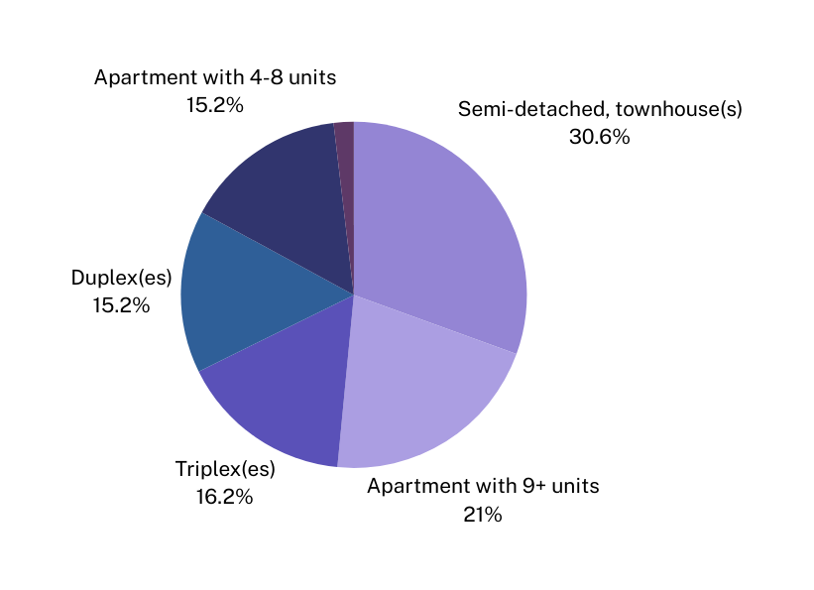
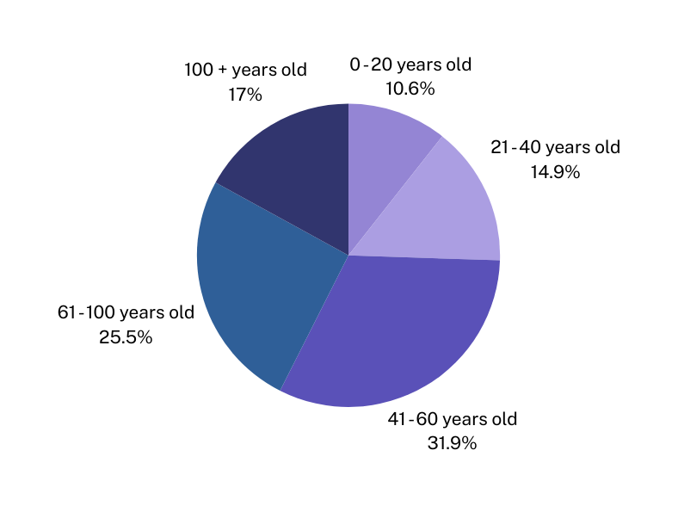
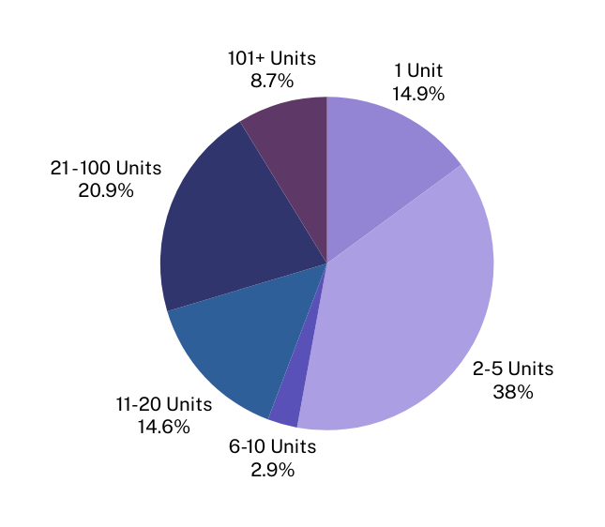
Landlord Survey Demographics
  36 respondents
  Responsible for nearly 800 rental units in Owen Sound (estimated to be about 40% of the rental market)
“What type of units do you own/manage?
“How many units are you responsible for?”
“What is the age of your rental stock?”

Slide 5





Survey Demographics
Tenant Survey
  545 valid responses (estimated to be about 28% of rental units
  Indigenous community members and newcomers to Canada were well represented
  47% of respondents in co-operative, non-profit, or county housing
  Individual (30%), company/corporation (23%)
  45% of respondents living in duplex or triplex
  Semi-detached, townhouse, single family (20%), apartment building with 4-8 units (20%), apartment building with 9+ units (16%)
  26% of respondents were living alone
  1+ roommates (23%), couple w/o children (22%), couple with children/multigenerational (20%), single parent (10%)
  29% of respondents reported household income of $50,000 - $74,999
  26% reported $30,000 - $49,999, 26% reported $75,000 or over, 20% reported under $30,000
  40% reported living in a rental unit in Owen Sound for the past 1-5 years
  31% reported 6-10 years, 20% reported 11+ years, 9% reported less than 1 year

Slide 6



Landlord Survey Findings
Maintenance
Housing Conditions
Tenant Relations
  19% of respondents reported all of their units required repairs costing over $1,000 per year
  32% of respondents reported less than 10% of units requiring repairs over $1,000; 19.4% reported none of their units
The most frequently reported rental unit problems (presented as % of affected units) include:
35%
of respondents reported difficulty in accessing unit
  Plumbing leaks (≤18%)
  Broken windows (≤15%)
  Broken or non-functioning exterior door locks (≤14%)
  Bedbugs (≤14%)
  Mice (≤13%)
  Pet damage (≤10%)
  Cracks or holes in walls floors or ceilings (≤9%)
  Heat not working (≤12%)
  Evidence of mould (≤3%)
  Water leaks or flooding from outside (≤2%)
to complete repairs, with entry refusals and difficulty contact tenants being the most frequently reported challenges
Other concerns reported by landlords effecting between 3 - 18% of the units include:
  Housekeeping issues resulting in additional costs
  Conflict/stressful situations with tenants
  Hoarding issues resulting in additional cost
  Illicit activity requiring police intervention
50%
of respondents reported
difficulty hiring contractors
to complete repairs in Owen Sound, with timing/availability being the most frequently reported challenge
Respondents reported that 12 to 30% of the units had damage caused by tenants / guests beyond expected wear and tear. Non-payment and conflict between tenants were similarly reported issues

Slide 7

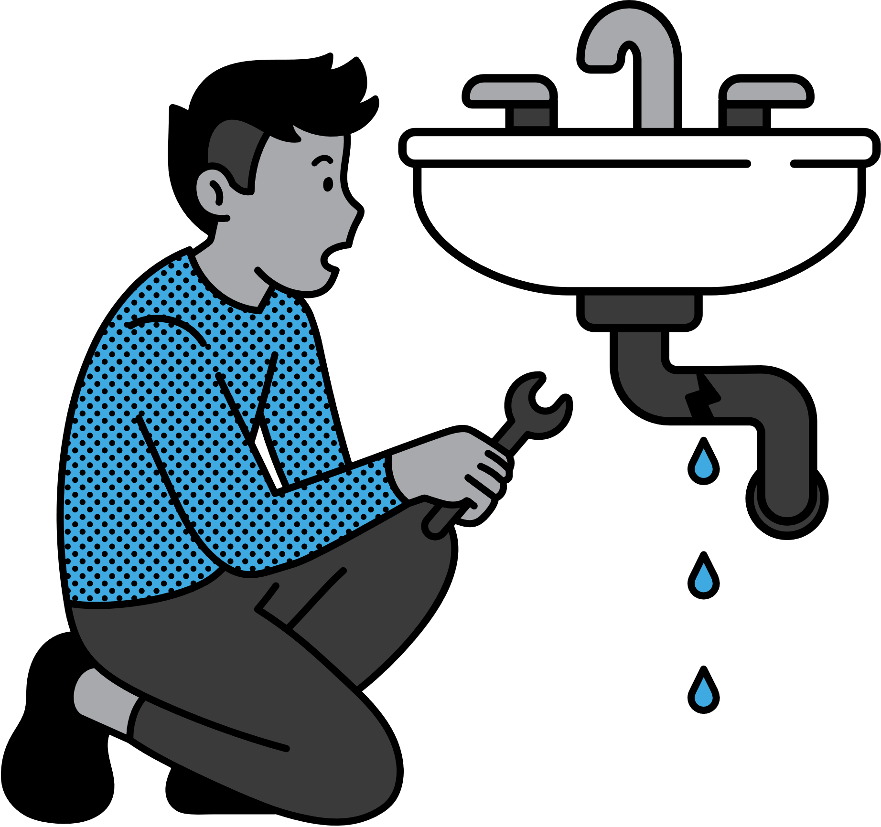
Tenant Survey Findings
Maintenance
Housing Conditions
Landlord Relations
  77% of respondents reported requesting maintenance in the past year
  35% of respondents had requested mainenance and it was completed
  27% of respondents had requested maintenance and it was not yet completed
  15% of respondents reported their landlord doesn’t intend to address their concerns
Reported rental unit problems (presented as % of respondents) include:
  Nearly all respondents (95%) reported knowing how to contact their landlord when needed, and reported prompt responses (82%)
  Over half reported feeling comfortable raising issues with their landlord (55%)
  Just under half of respondents reported issues with requesting maintenance (49%) such as delays in completing the work, refusal to do the work, being unable to reach the landlord or having a poor relationship with the landlord
  Pests/insects other than bedbugs (73%)
  Unit too hot or too cold (71%)
  Water leaks (62%)
  Anxiety regarding their unit’s physical condition (60%)
  Had left a unit in the past due to poor conditions (57%)
  Noise (51%)
  Drafty doors (49%), dysfunctional windows (49%)
  Mould (47%)
  Poor air quality (43%)
  Bedbugs (42%)
Housing Cost
75%
of tenants reported spending 30%+ of their income on housing
87%
of respondents reported wanting to leave
due to poor conditions but not being able to

Slide 8
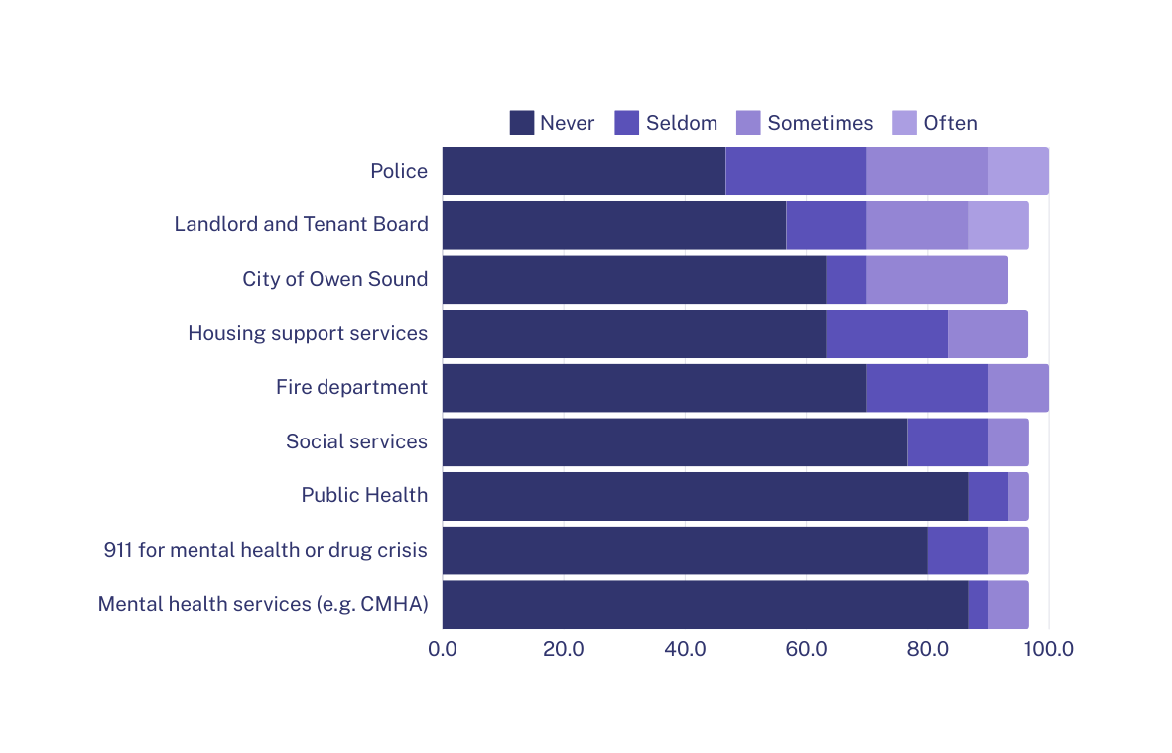
Landlord Survey Findings
What local services were landlords accessing for tenants?
% of respondents
  Landlords reported highest degrees of satisfaction with fire department (8/9 satisfied), and police (12/16 satisfied).lower levels of satisfaction with the Landlord and Tenant Board (2/12 satisfied), City of Owen Sound (4/9 satisfied), housing support services (5/8 satisfied), and social services (0/6 satisfied).

Slide 9
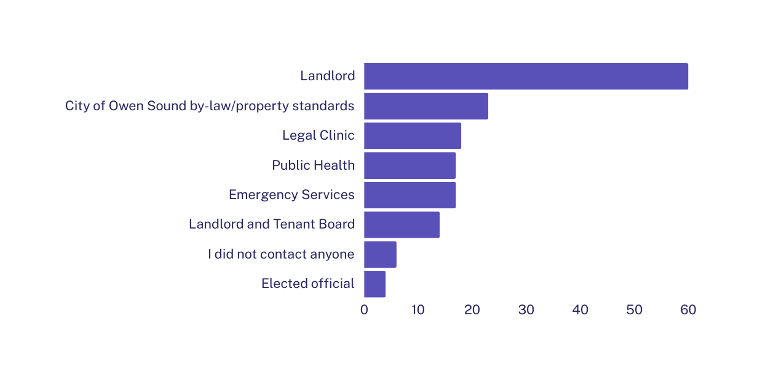
Tenant Survey Findings
When you had a concern about unsafe or unhealthy conditions in your unit, who, if anyone, did you contact?
% of respondents
  Tenants reported lower levels of satisfaction with Housing Support Services (31% dissatisfied), Mental Health Services (29% dissatisfied), and City of Owen Sound (28% dissatisfied). Highest degree of satisfaction with fire department (47% satisfied), Social Services (44% satisfied), and the Landlord and Tenant Board (43% satisfied).

Slide 10
Landlord Survey Findings
Plans for the future (presented as % of respondent’s units)
  7 - 16% of are expected to have major renovations and rent will be increased
  4-6% are expected to be sold to outside investors
  4-6% are expected to be sold to local buyers
  1-12% are expected to have major renovations but rents will be kept at/near current level
  Up to 2% are expected to be converted into short-term rentals
  Up to 3% of units are expected to be made into supportive housing
  Less than 1% are expected to be taken over for personal use

Slide 11
Points of Connection
Unit quality concerns
  A large majority of tenant respondents reported some sort of quality concern with units
  Landlords and tenants both commonly reported issues related to temperate control (including broken/impaired windows), plumbing and water leaks, pests and bedbugs, and mould
Landlord concerns
Tenant concerns
  Plumbing leaks (≤18%)
  Broken windows (≤15%)
  Broken or non-functioning exterior door locks (≤14%)
  Bedbugs (≤14%)
  Mice (≤13%)
  Pet damage (≤10%)
  Cracks or holes in walls floors or ceilings (≤9%)
  Heat not working (≤12%)
  Evidence of mould (≤3%)
  Water leaks or flooding from outside (≤2%)
  Pests/insects other than bedbugs (73%)
  Unit too hot or too cold (71%)
  Water leaks (62%)
  Noise (51%)
  Drafty doors (49%)
  Dysfunctional windows (49%)
  Mould (47%)
  Poor air quality (43%)
  Bedbugs (42%)
  Large cracks in unit (37%)

Slide 12
Points of Connection
Lack of trust and communication
  Landlords reported challenges with contacting tenants and accessing units to complete repairs
  Tenants reported a lack of comfort with landlords accessing unit
Landlord concerns
Tenant concerns
  35% of respondents reported challenges in accessing a rental unit
    42% of those who reported challenges cited tenant refusal
    37% of those who reported challenges cited not being able to reach the tenant
    26% of those who reported challenges cited concern for personal safety
    21% of those who reported challenges cited concern for tenant’s mental health
  56% of tenants reported being comfortable with landlords accessing unit
    25% reported being somewhat uncomfortable, 9% reported being uncomfortable
  Tenants whose landlord lived in the same building as their landlord/property manager were 19% more likely to report anxiety, worry, nervousness or lack of sleep related to the physical conditions of their housing

Slide 13
Points of Connection
Lack of satisfaction and effects on wellbeing
  Approximately 1/3 of landlords reported a lack of financial and/or personal fulfillment with being a landlord in Owen Sound
  A significant proportion of tenants reported poor conditions and/or feelings of being unsafe in their unit
Landlord concerns
Tenant concerns
  38% of respondents either disagreed or strongly disagreed with the prompt “I find it financially rewarding to be a landlord/property manager in Owen Sound”
  34% of respondents disagreed or strongly disagreed with the prompt “I find it personally rewarding to be a landlord/property manager in Owen Sound”
  35% of respondents disagreed or strongly disagreed with the prompt “I would recommend being a landlord/property manager to a friend or family member”
  41% of respondents disagreed or strongly disagreed with the statement “Five years from now, I could see myself being a landlord/property manager in Owen Sound”
  Wanted to move due to poor conditions but couldn’t (87%)
  Anxiety regarding their unit’s physical condition (60%)
  Had left a unit in the past due to poor conditions (57%)
  Not comfortable raising issues (34%)
  Feel unsafe (29%)

Slide 14


Points of Connection
Unit quality concerns
Lack of satisfaction
Lack of trust and communication

Slide 15
Quotes from Survey Respondents
“Why do we not have a certain standard that landlords have to keep places in…should be inspections done in rentals, fire, home inspections.” – Tenant survey respondent
The reason substandard housing exists in Owen Sound is simply the fact the City allows it to by its lack of bylaw enforcement” – Landlord survey respondent

Slide 16
We Are All Neighbours
  Charm of small town living in Owen Sound, however:
    Older housing stock related to rental unit quality issues
    Older housing stock and lack of available units
    Tenant affordability and landlord financial incentive
Landlords feeling stuck
Tenants feeling trapped
“Government incentives for improved efficiencies such as windows/doors/ heating are only available for homes that you own and live in as your primary residence. How does that help the tenants to live in the best possible home?” – Landlord survey respondent
“With the rising costs of rental units, many are unable to afford an increase in rent to move to a new unit so they are stuck where they are. Living in an unsafe and unhealthy home should not be ‘better than being homeless’” – Tenant Survey respondent

Slide 17
How Do We Move Forward?
Improving condition of rental units
Improving trust and communication
Strengthening community supports

Slide 18
Recommendation #1: Collection of data
We recommend that the City collects data on habitability issues in rental housing (for example, the incident of mould, pests, water leaks, broken windows, etc) via bylaw and fire department inspections.
This data is important to better understand the depth of the issues facing older housing stock in the City and in developing strategies to encourage and support landlords to maintain existing housing stock that is safe and healthy.
Notes:
Short-term solutions, low budget. Not a fancy database. Share annually or bi-annually. Public Health, Fire Department and Bylaw tracking proactively housing standards problems.

Slide 19
Recommendation #2: Include model bylaw language for mould repairs in Owen Sound’s bylaws
The Municipal - Public Health Provincial Working Group to Address Substandard Housing Issues, a successful intersectoral collaboration that was catalyzed by the province-wide RentSafe work, recently developed a model by-law on mould for use by municipalities across the province. The Working Group unites the efforts and expertise of the leading professional associations serving public health inspectors and municipal by-law/property standards officers across Ontario.
Its members include: Ontario Association of Property Standards Officers (OAPSO), Municipal Law Enforcement Officers Association of Ontario (MLEOA), Ontario Public Health Association (OPHA), Canadian Institute of Public Health Inspectors - Ontario Branch (CIPHI-ON), Association of Supervisors of Public Health Inspectors of Ontario (ASPHIO) and RentSafe.
The mould model by-law, now available through the Ontario Association of Property Standards Officers (OAPSO), was informed by a comprehensive scan of existing by-laws across Ontario and co-created with the expertise of both public health inspectors and municipal property/by-law officers. The model by-law supports municipalities across the province to update and improve municipal property standards regarding mould in rental housing.
Notes:
Mould Model Bylaw – add the language to the City bylaw. Short-term solutions. Gives clarity to tenants and landlords on definition of significant mould and outlines responsibilities. We heard a high number of tenants reporting water leaks which leads to significant mould issues. Long term exposure to mould impacts children’s health.

Slide 20
Recommendation #3: Prioritize supports for landlords to maintain the habitability of their units and to facilitate effective tenant-landlord interaction as a key strategy in retaining and improving the existing rental housing stock in Owen Sound
We are currently in a housing crisis with increased incidents of homelessness. Households and individuals are turned away every day from accessing Grey County emergency housing because of lack of space. Not only is more housing required but we also want to keep and maintain our existing affordable rental housing stock and retain existing tenancy for long-term stability for both landlords and tenants.
The City should play a role in retaining existing rental housing stock, informed by better data on habitability concerns, and via supports to ensure that both tenants and landlords are equipped to fulfill their responsibilities to maintain healthy conditions. The City should be involved in helping to find solutions to maintain a robust, healthy and financially diverse rental housing market for the Owen Sound community.
Notes:
The slide says “should” but it should say “we invite the City to be involved in solutions for safer and affordable housing”. Be part of the solution.

Slide 21
Systematic Change: What long term changes do we need to ensure that existing rental housing stock in Owen Sound is affordable, healthy and safe for all?
Explore options for pro-active inspections to avoid a complaint driven process similar to restaurant inspections system
Improvements with the Landlord and Tenant Board process to make it more accessible and proactive
Strong community involvement and reporting mechanism to ensure long term stability, such as a City / Public Health rental housing committee
Explore options for renoviction bylaws to prevent bad faith evictions and maintain affordable housing stock (similar to examples in Hamilton and Toronto)

Slide 22
Miigwetch
Thank you
Merci
https://rentsafe.ca/owen-sound/
Interested to learn more or get involved?
Contact:
Erica Phipps (erica@healthyenvironmentforkids.ca)
Seana Moorhead (seana.moorhead@gbclc.clcj.ca )
Jill Umbach (povertytaskforce@unitedwaybg.com)
Full Report Available at:
https://rentsafe.ca/owen-sound/

